Slide 1
UNIT 1 SUSTAINING ECOSYSTEMS
Chapter 4
Sustaining Aquatic Ecosystems
Science 1206

Slide 2
Earth: The Blue Planet
Water covers more than two thirds of our planet
97% of the water is saltwater
Which we cannot drink
Oceans control weather systems and provide a constant supply of water through evaporation
Freshwater is stored as snow and ice
Only 0.0005% is available to sustain human population

Slide 3
Aquatic Ecosystems: Introduction
Aquatic ecosystems are generally less productive than terrestrial ecosystems
They can support only a fraction of the organisms that can be found on land
Soil - 50kg biomass
Ocean – 5kg biomass
Abiotic conditions are very different from those found on land

Slide 4
Abiotic Factors in Lakes
There is considerable variation among aquatic ecosystems
Swamps, lakes, ponds, marshes, rivers, and marine ecosystems all have distinct abiotic factors that require specific adaptations for those organisms that live there
While on the surface all water may appear the same, below there are many differences
Can you think of any abiotic factors that change in the water?
Light levels, O₂ levels, temperature, available nutrients

Slide 5
Lake Structure
Littoral Zone
Area extending out from the lakeshore to where rooted plants can no longer be found
Lilies and bulrushes
Limnetic Zone
Area of the lake where there is enough light for photosynthesis to occur
Mostly occupied by plankton
Profundal Zone
Area beneath the limnetic zone where there is insufficient light for photosynthesis
Main source of nutrients is detritus (decaying plant and animal remains)
See figure 1 on page 126 in textbook

Slide 6
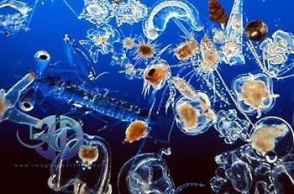
Plankton
Autotrophic and heterotrophic micro organisms
Autotrophic are phytoplankton – algae and tiny plants
Heterotrophic are zooplankton – tiny insects
May feed on zooplankton
Both provide nutrients to higher-level consumers

Slide 7
Importance of Decay
As plants and animals die, their remains sink to the bottom of the water
Bacteria and bottom-dwelling organisms break down their remains (detritus) returning nutrients to the soil for plants to grow
Bacteria use up the oxygen, thus reducing O₂ levels in the water
Absence of sunlight and plants in the profundal zone to replenish oxygen, may lead to low oxygen levels
Very few organisms can tolerate low nutrient and oxygen levels

Slide 8
Two Kinds of Lakes - Oligotrophic
Features
Tend to be deep and cold
Low nutrient levels (limiting the size of producers)
Water tends to very clear because there are so few organisms
Oligotrophic lakes gradually become eutrophic over time
Eutrophication
May be sped up by humans by adding excess nutrients to the system

Slide 9
Two Kinds of Lakes - Eutrophic
Features
Tend to be shallow and warmer
Excellent supply of nutrients
Often the water is murky (cloudy) because favourable abiotic factors lead to high numbers of organisms
Fig. 2 pg. 127 shows the progressions from an oligotrophic to eutrophic lake

Slide 10
Seasonal Variations in Lakes
Like many substances, as water cools, it becomes more dense
Going from gas (low density) to liquid (higher density)
However, a strange thing happes as it cools below 4ºC, it becomes less dense
This is why ice floats, forming a layer on top of cold water and the lowest layer in a lake or the ocean tends to be 4ºC

Slide 11
Lakes in Winter
Often covered in ice and snow, preventing atmospheric oxygen from dissolving with the water
The water is layered according to density
Ice
Water at 0ºC – 3.9ºC
Water at approx. 4ºC
These layers are the same regardless of how cold the air is, though the ice layer will thicken
If the ice is thin enough, and not covered in snow, light can penetrate enough to allow some photosynthesis to occur
Without which, O₂ levels may drop, which may lead to massive die-offs each winter because larger organisms cannot tolerate the low O₂ levels

Slide 12
Lakes in Spring
Spring brings storms and melting ice
Oxygen can now pass into the water from the air
Wind creates waves that increase surface area and the rate of O₂ dissolution
As the water warms to 4ºC it sinks below the less dense water carrying the O₂ with it
This mixing is called spring turnover

Slide 13
Lakes in Late Spring
As surface water warms above 4ºC it will no longer sink because it is less dense than the cooler water below
The thermocline decreases for the summer
Layers in the lake are:
Epilimnion – top layer of water that warms in the summer and remains water beneath ice in winter
Hypolimnion – the bottom which remains at low temperature in summer and about 4ºC in winter
Thermocline – The narrow region between the hypolimnion and epilimnion where the temperature drops from warm to very cool

Slide 14
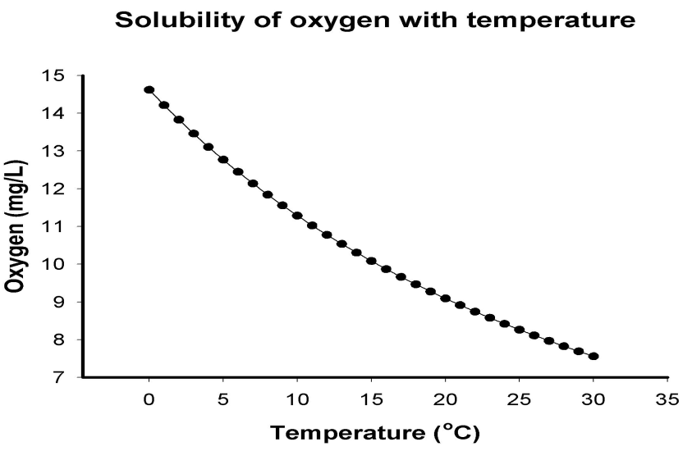
Lakes in Summer
The epilimnion and hypolimnion do not mix during the summer
This reduces oxygen movement to the hypolimnion, so organisms must use O₂ reserves from spring turnover
In the epilimnion it is warm, as the temperature increases the amount of dissolved oxygen decreases
During a hot spell, organisms, like trout, in a shallow lake may die

Slide 15
Lakes in Fall
As temperature drops, surface water begins to cool
As water cools to 4ºC it sinks down through the lake
Fall turnover renews O₂ levels to the hypolimnion, breaking up the summer thermal layers

Slide 16
Individual Lake Variations
All lakes have their own unique conditions that determine the species that are able to live in them
Ex. Trout are unable to tolerate low O₂ levels, so they would be confined to cooler lakes that have higher O₂ concentrations in the summer, while perch can live in warmer lakes, because they can tolerate low O₂ levels
The littoral zone is the most productive part of a lake
The size of this zone depends on the slope of the lakebed

Slide 17
Similarities Among Lakes
Central Canada & Newfoundland
Formed when glaciers gouged out basins in granite bedrock
Tend to be oligotrophic since because minerals in granite do not dissolve easily
Atlantic Region
Also glacial in origin
May be oligotrophic or eutrophic depending on the bedrock
As minerals dissolve,

Slide 18
Similarities Among Lakes
Prairie Provinces
Also glacial in origin (we are in Canada after all)
Formed in thick sand and gravel making them rich in soluble nutrients, with productive ecosystems
They tend to be very shallow and collect sediments more quickly
Arctic Lakes
Because of the low temperatures some lakes experience only one turnover
Some may not thaw

Slide 19
Sources of Water Pollution
Water Pollution
Any chemical or physical change in the surface water or ground water that can harm living things
Biological, chemical and physical forms of water pollution are grouped into 5 categories

Slide 20
Sources of Pollution

Slide 21
Categories of Pollution 1. Organic Solid Waste
Sources
Human sewage, animal wastes, decaying plant life, industrial waste (ex. Pulp mills)
Effects
Oxygen in the water is used up as organic matter is broken down by bacteria.
Decomposition may cause a foul odour
Water is often fairly clear and smelly as a result, eutrophication may take place

Slide 22
Categories of Pollution 2. Disease-causing organisms
Sources
Human sewage and animal wastes that enter the aquatic ecosystem with runoff
Effects
These organisms may cause an outbreak of waterborne diseases like cholera, typhoid, infectious hepatitis, beaver fever or dysentery
Beaver fever has been in the Conne Water supply in the past
Hepatitis is common in countries like Cuba

Slide 23
Categories of Pollution 3. Inorganic Solids and Dissolved Mineral
Sources
Acids from combustion and refining of fossil fuel
Salts from irrigation, mining and road runoff
Fertilizers from farms and gardening runoff
Mineral solids from soil erosion after clear cutting
Effects
Kills bacteria and injures trees
Salts kill freshwater organisms, and render water unusable and undrinkable
Fertilizers cause algal blooms resulting in eutrophication
Solids make water murky (turbid) harming plants, and increase sediment formation, harming bottom feeders

Slide 24
Categories of Pollution 4. Heat
Sources
Electricity generating plants and other industries that use water as a coolant, and pump it back into the ecosystems
Effects
Addition of warm water to ecosystems decreases the solubility of oxygen in the water
This works in the favour of fish in Bay d’Espoire, since the salmon are able to grow faster in the waters that have been warmed by the NL hydro station

Slide 25
Categories of Pollution 5. Organic Chemicals
Sources
Oil and grease from roads
Pesticides from farms, parks and gardens
Detergents (organic phosphates) from washing of clothes, cars, dishes, etc.
Effects
Toxic to fish and waterfowl (birds), oils reduce O₂ exchange with the water from the air
Some pesticides damage entire food chains through bioaccumulation & bioamplification
Phosphates can lead to eutrophication
And you thought you only needed those terms for chapter 1?

Slide 26
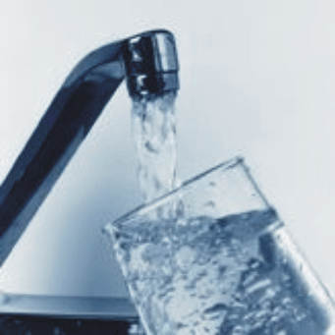
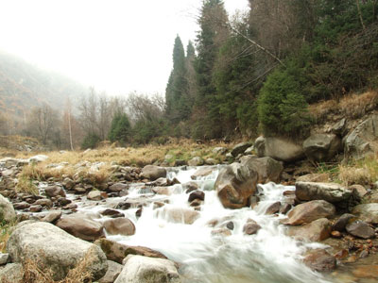
Water Quality Indicators
Water quality is defined by its intended use
Water unacceptable to drink is often suitable for watering plants or industrial processes
Water too polluted for swimming may still be suitable for boating or fishing
There are three main indicators of water quality:
Bacteria count
Dissolved Oxygen
Biological Oxygen Demand (BOD)

Slide 27
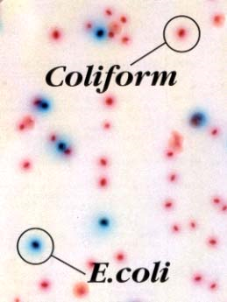
1. Bacteria
Coliform bacteria
Naturally occurring in the intestines of humans and many animals
Presence of this type of bacteria in water indicates that there is human or animal waste polluting the water
Water is plated on a special medium that allows the bacteria to grow if it is present

Slide 28
2. Dissolved Oxygen
There are several solutions available to detect O₂ levels. The solutions change colour in the presence of oxygen
There are also probes attached to computers that are often used to detect dissolved O₂ levels
The number of organisms may also indicate the level of oxygen, but this low numbers may be attributed to the toxins themselves, not simply the presence or absence of oxygen
Normal levels are between 8 and 14 mg/L

Slide 29
3. Biological Oxygen Demand (BOD)
It is possible to measure the amount of dissolved oxygen needed by decomposers (bacteria) to break down organic matter in a sample of water over a 5-day period at 20ºC
BOD indicates the amount of available organic mater in a water sample
A cold, less productive lake may have a BOD of 2 mg/L of oxygen, while a warmer very productive lake may be as high as 20 mg/L
As the number of organisms increases, the biological demand increases, and so dissolved oxygen levels decrease

Slide 30
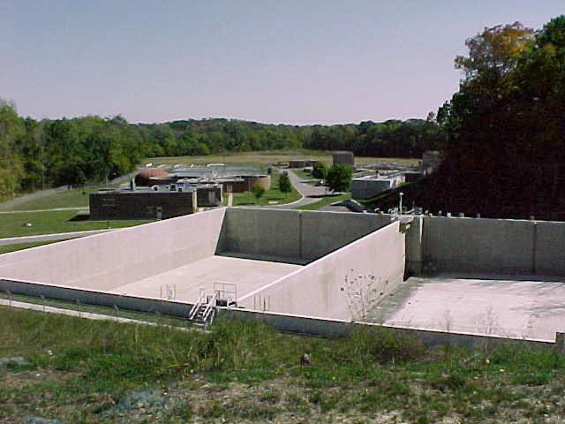
Sewage, Decomposers and O₂ levels
Too many nutrients can create problems for lakes
Think about what happens when cities dump raw sewage into water systems… What happens?
The greater the amount of decaying matter, the greater the population of bacteria
Eventually all fish will die, as the bacteria use up all the oxygen – this adds more detritus and thus more bacteria
Human wastes add additional phosphates and nitrates, promoting plant and algal growth, and this more detritus still
Each time organic matter is returned to the lake, oxygen levels are further reduced

Slide 31
Thermal Pollution
Summer-like conditions are often the result of lakes polluted with warm water from industry or power stations
Often the warm water prevents water from freezing in the winter
The result is organisms thriving all year round when they would normally be dormant
May lead to O₂ depletion in the hypoimnion, and increased eutrophication as organisms die

Slide 32
Point vs. Non-point Pollution Sources
Point Sources
Non-point Source
Pollutants enter the water in high concentrations and slowly dilute into the ecosystem
Point of entry at high concentration has more severe effects than further away in diluted areas
Ex. Faulty treatment plant, oil tanker spill
Pollutant sources are widespread – not from one single source of input
Rarely have a single area of severe damage
Are often variable (changing) and repeating over time
Ex. Farming fertilizers, road salt runoff

Slide 33
Identify the point and non-point sources of water pollution

Slide 34
Section Review Documentary
In groups of two or three (created by Mr. O)
You are going to create a documentary about aquatic ecosystems
How are they important?
What types of organisms can one find? (research)
How are lakes structured? How are lakes in NL formed? What types of lakes are found in Canada?
How do lakes change throughout the year?
Pollution – Sources, effects and the importance of keeping our freshwater clean

Slide 35
Project Instructions
You will create a video documentary about aquatic ecosystems
You will need to create some script for the interviewer and the “experts” being interviewed
You will use a digital camera to record your documentary
Use a program like Windows Movie Maker to add your Intro titles, snip the video clips up, add visual effects and closing credits
If you need help with this ask, but it is very easy with WMM, which is on every computer with Windows on it
Submit your final Movie and script to Mr. O Next week
BE CREATIVE

Slide 36
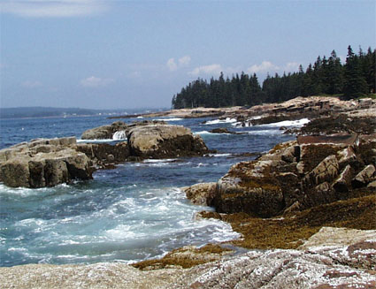
Marine Ecosystems
Abiotic Factors
Salt – avg. 3.5% salt
Tides – gravitational pull of water by the moon
Sunlight – penetrates only about 200 m down
Nutrients – Concentrated near the bottom and near the shoreline regions
Biotic Factors
Along the continental shelf life is more dense than in the open ocean

Slide 37
Major Life-Zones of the Ocean
Photic “light” Zone Supports photosynthesis Aphotic “dark” Zone
Insufficient light for photosynthesis, though chemosynthesis may occur

Slide 38
Ocean Regions
Open Ocean
Cool water, contains fewer minerals and nutrients
Coastal Zone
Extends from the continental shelf inward to the high-tide mark on land
Accounts for 10% of the ocean, with 90% of the life
Two areas
Neritic zone
Intertidal zone
See figure 1 page 146 in textbook

Slide 39
Intertidal Zone
Defined by low and high tide
Organisms must be able to withstand crushing forces of the waves during high tide and drying periods during low tide
Sucker-like feet and fibers attach organisms to the rocks
Clams, mussels, starfish, seaweed, seagrasses

Slide 40
Neritic Zone
Water just beyond of the intertidal zone
Depth depends on the slope of the continental shelf
May be very shallow or very deep
Does not exceed 200 meters
The Grand Banks of NL are the neritic zone of the east coast
Clams, mussels, lobsters, crabs, various fish

Slide 41
Estuaries and Coastal Marshes
Tidal Marshes are the most productive of all marine ecosystems
Periodically flooded by high tides, but the large area allows plants to photosynthesize
High diversity of both plants and animals
Estuaries exist where freshwater is flowing into the ocean
Such as Conne River
Water in the estuary is a combination of fresh water floating on top of the salt water
Salt water is more dense than freshwater
Freshwater carries nutrients that allow the estuary to be more productive
The drastic changes in salinity (saltiness) from tides makes it difficult for many species to live here

Slide 42
Estuaries and Coastal Marshes
Salt Marsh
Estuary

Slide 43
Marine Food Web Example

Slide 44
Marine Pollution “All drains lead to the ocean” – Finding Nemo
Many pollutants from terrestrial and aquatic ecosystems are carried to the oceans, where they spread out and become more diluted
Most productive ocean areas are also the ones with the greatest productivity

Slide 45
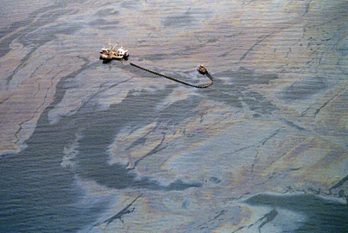
Crude Oil in Marine Ecosystems
Major sources of oil
Tanker accidents
Offshore wells
Daily washing of tankers
On-land activities
Waste oil disposal (50%)
The atmosphere
From oil fires

Slide 46
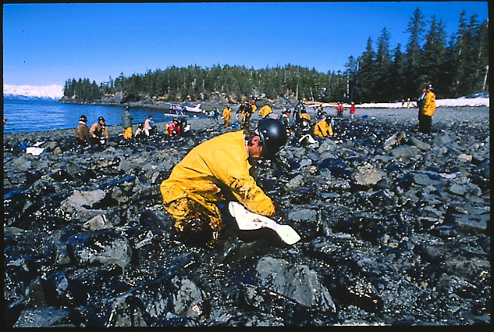
Ecological Effects of Oil Pollution
Lighter oils float, this affects birds
Coats feathers, dissolving natural oils that waterproof the birds
Destroys the insulation, resulting in hypothermia
Heavy oils sink and affect bottom-dwelling organisms
Sludge covers and suffocates organisms like crabs and oysters
All oils eventually enter the food chains of fish, birds and people

Slide 47
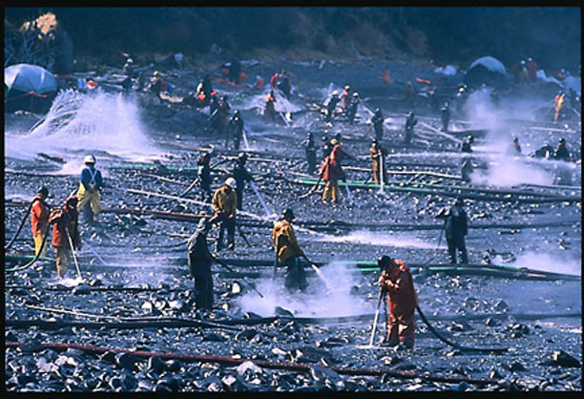
Cleaning Up The Oil
A very expensive task (over 3 billion dollars)
High-pressure hoses spraying hot water clean the shoreline
This often does more damage than good
Floating sponges sop up oil before it reaches land
Crude oil may clean up naturally after 3 years, while refined oil may take more than 10 years

