Slide 1
UNIT 1 SUSTAINING ECOSYSTEMS
Chapter 2
Change and Stability in Ecosystems
Science 1206 / 2200

Slide 2
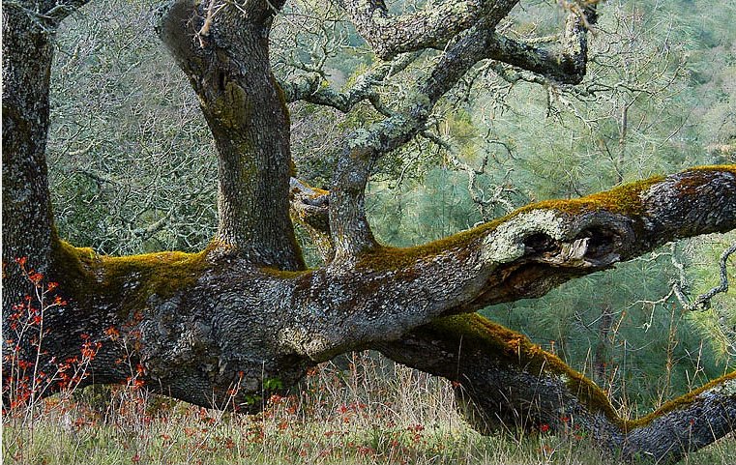
Change & Recovery in Ecosystems
What happens to the materials that make up a truck when it begins to rust?
What happens to the tree after it dies?

Slide 3
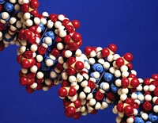
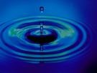
Cycling of Matter in Ecosystems
Organic substances
Contain atoms of Carbon and Hydrogen
Are broken down into simpler forms in living things
Ex. Sugar, carbohydrates, proteins, amino acids
Inorganic substances
Does not contain combination of carbon and hydrogen
Ex. Water (H₂O), ammonia (NH₃), Carbon dioxide (CO₂)

Slide 4
Biological Processes Involved in Nutrient Cycling
Photosynthesis
Plants convert CO₂ and H₂O into O₂ and sugar
6CO₂ + 6H₂O + energy → C₆H₁₂O₆ + 6O₂
Respiration
Animals AND plants use O₂ and sugar, converting it to CO₂ and H₂O
C₆H₁₂O₆ + 6O₂ → 6CO₂ + 6H₂O + energy

Slide 5
More Processes
Decomposition
Remains of dead organisms are broken down by bacteria and fungi
All molecules are released into soil
Excretion
Waste material from animals is broken down and returned to the soil
Assimilation
Conversion of molecules into a useable form by bacteria
Nitrification, denitrification

Slide 6
Cycling of Organic Matter
The atoms and molecules available to make up organisms on earth is limited
All the atoms MUST be recycled in order for new organisms to form.
It is very likely that at least one of the carbon atoms in your body was also in a 70 million year old dinosaur

Slide 7
Recycling of Matter by Micro-organisms

Slide 8
The Matter Cycle
Soil
Grass
Cow
Person
Decomposers
Dead plants and animals are broken down by decomposers – their atoms / molecules are released into the system to be re-used
Atoms, molecules accumulate in the soil
Nutrients are taken up by grasses
Cows eat the grass – nutrients and atoms are passed on to the cow
Person eats cow – nutrients and atoms are passed on to person
Each of these things can die, the atoms are broken down by decomposers and recycled for the next living things

Slide 9
The Oxygen Cycle
Respiration:
C₆H₁₂O₆ + 6O₂ → 6CO₂ + 6H₂O + energy
Photosynthesis:
6 CO₂ + 6 H₂O + light → C₆H₁₂O₆ + 6O₂
What do you notice about these two chemical reactions?

Slide 10
The Oxygen Cycle
Oxygen
(in atmosphere)
RESPIRATION by plants, animals and decomposers
Carbon Dioxide
(in atmosphere)
PHOTOSYNTHESIS
by green plants
Combustion
(burning stuff)

Slide 11
The Carbon Cycle
CO₂ in the atmosphere
Photosynthesis - carbon is stored in the biomass
volcanic eruption
CO₂ dissolved in water
combustion
Glucose
Aerobic respiration
Ocean sediment
Decomposition
Weathering
Conversion to fossil fuels
Fossil fuels

Slide 12
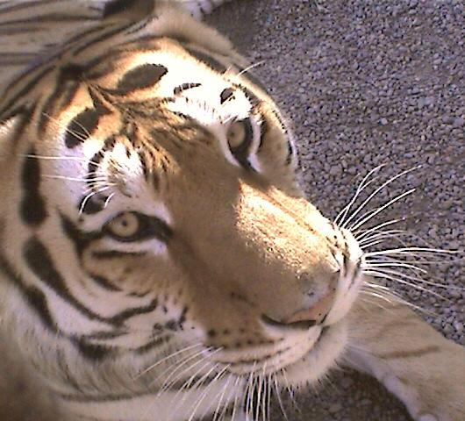
The Carbon Cycle
Two groups of carbon sources in the carbon cycle
Biotic - Aerobic respiration (in the presence of O₂), and decomposition
The organic reservoirs (storage areas) for carbon are the bodies of living things
Abiotic - Combustion and geological activity
The inorganic reservoirs for carbon are the atmosphere, the oceans, and the Earth’s crust

Slide 13
The Nitrogen Cycle
The movement of nitrogen through the ecosystems, the soil, and the atmosphere is called the nitrogen cycle. Nitrogen gas composes 79% of the Earth’s atmosphere. In order for nitrogen to be useful to organisms, it must be available as a nitrate ion (NO₃⁻). Atmospheric nitrogen is converted into nitrates by the process of nitrogen fixation, or nitrification, either by lightning or by bacteria in the soil
Nitrogen is required to make proteins and DNA which is the genetic material found in every cell.

Slide 14
The Nitrogen Cycle

Slide 15
The Nitrogen Cycle
Essential to living things for the production of amino acids used to synthesize proteins, and nucleic acids which are used to carry the hereditary or genetic code
Plants and animals are unable to use any of the N₂ that is in the atmosphere
The nitrogen cycle can occur in both terrestrial and aquatic ecosystems

Slide 16
Nitrogen Cycle
Complex cycle can be simplified as follows
plants to make use of nitrogen it must first be converted into ammonia or nitrates (NO₃⁻)
two pathways that produce nitrate ions:
fixation by lightning (produces nitrates directly)
fixation by bacteria (producing ammonia) followed by nitrification by bacteria (converting the ammonia to nitrates)
(ANIMATION)

Slide 17
Question
IN YOUR NOTEBOOK, ANSWER THE FOLLOWING QUESTION
What are some ways that the balance of the carbon cycle is affected by human activity?

Slide 18
The Greenhouse Effect
The cause of global warming
Excess CO₂ in the atmosphere acts like a blanket
Where does the CO₂ come from?
Burning of fossil fuels in factories and cars
Mining → removing more carbon from the earth
Burning of rainforests → clearing farmland
Destruction of rainforests reduces the number of trees to remove the CO₂

Slide 19
Global Warming
Describes the increase in the earth’s atmospheric and ocean temperatures
Caused by the Greenhouse effect
Radiation reaches earth from the sun
Some is blocked by the ozone layer, some not
Heat radiation reflects from the earth back into space
CO₂ and Methane (CH₄) in the atmosphere absorbs some of this heat, reflecting it back to earth
The Result → The earth then gets warmer

Slide 20
Effects of Global Warming
General Effects
Effects on Ecosystems
Increase in global temperature
Changes in climate
Increasing ocean levels
Decreased Ozone layer
Species forced out of habitats (possibly to extinction)
Other species may flourish
Less snow cover = less protection for some species
(ANIMATION)

Slide 21
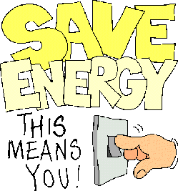
What Are We Doing About It?
Reducing CO₂ output
1-tonne challenge, electric/ hybrid cars
Cutting back on energy consumption
Kyoto Accord
Global agreement to reduce emissions
Reducing deforestation

Slide 22
Nutrient Cycling, Interrupted
IN YOUR NOTEBOOK
How do you suppose human activities affect the other chemical cycles?
Think about the effects of agriculture and industry

Slide 23
Affects on Carbon & Oxygen Cycles
Eutrophication
Fertilizer runoff increases growth in water
Increased nutrient levels released into the environment
In aquatic ecosystems – Number of organisms increases, O₂ levels decrease as consumption increases
The water becomes anaerobic (no oxygen), organisms die off
Habitat destruction & exotic species introduction

Slide 24
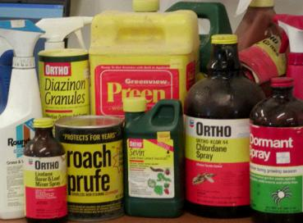
4 types of Pesticides
Herbicides → kills plants
Insecticides→ kills insects
Fungicides → kills fungi
Bactericides → kills bacteria
Antibiotics

Slide 25
Pesticides
First Generation
Second Generation
Substances such as sulfur, arsenic, lead and mercury.
Banned usage around the world
These are toxic to humans so people began to use plant extracts
Still can be found in fish populations around the world
Chemicals made in a lab
Synthetic pesticides
Not necessarily better than the first generation chemicals
Chemicals like DDT or Round-Up

Slide 26
Bioaccumulation & Bioamplification
Bioaccumulation
Bioamplification
Increase in concentration of a pesticide from the environment in all organisms in a food chain
Often insects consuming herbicides
The higher up the food chain, and thus the higher the trophic level, the higher the concentration of toxins
Top carnivores end up with the greatest concentrations of toxins
Figure 4 on page 54 in your book

Slide 27
Bioaccumulation

Slide 28
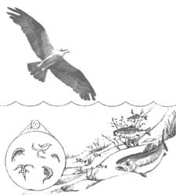
Bioamplification
Long-lived - Present for a long time in the system
Mobile - Easily passed up the food chain
Soluble in fats - Dissolves in, and is stored in fatty tissue
Biologically active – Affects biological body tissue

Slide 29
Bioamplification

Slide 30
Pesticides: Past and Present
Past Chemical Pesticides
Stored in fat tissue
Not soluble in water
Modern Chemical Pesticides
Not stored in fat tissue
Soluble in water

Slide 31
Pesticide Resistance
When pests become resistant to pesticides pesticide no longer effects them
Sometimes individuals have the genetic ability to resist a chemical. If all others die when they are sprayed, then the survivors are about to reproduce
A resistant population of pests is created

Slide 32
Resistance is Futile… Or Not

Slide 33
Dichloro-diphenyl-trichloroethane (DDT)
Pesticide that is suitable for bioamplification
Meets the 4 requirements
Has a half-life of 15 years
That is, every 15 years the amount left in the system will be reduced by one half.
If you use 100 kg of DDT, after 15 years it will be reduced to 50 kg, and after another 15 years it will be 25 kg, and so on.

Slide 34
Effects of DDT Usage in Borneo

Slide 35
Effects of DDT on Top Predators
Shell thinning
Carnivorous birds such as ospreys and bald eagles eat other birds, dead animals and fish which contain a build-up of DDT
DDT causes the shells to become too thin to allow the large females to sit on the eggs without them breaking
Since eggs are being broken, the over-all population of these birds is declining
After DDT was banned in the US and Canada in the early 1970’s the bird populations of recovered.
DDT bioaccumulates in humans the same as it would other animals
Male birds have also become more feminine as the DDT mimics female sex hormones

Slide 36
A Couple Final Questions
Not all countries, like Mexico for example, have banned the use of DDT
Since birds migrate from winter to summer from one country another, do you think the birds are 100% safe from the presence and the effects of DDT? Why?
How do you think a pesticide like DDT would affect the over all biodiversity in an ecosystem?

Slide 37
Chapter Two Review & Test
Chapter Review questions: Handout due: ________________
Chapter 2 Test date: ____________________

