Slide 1
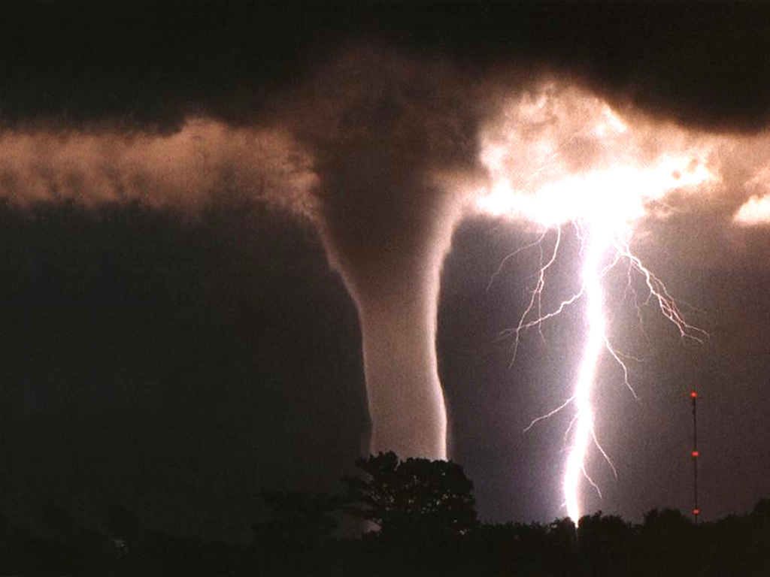
Chapter 15
Extreme weather events
By: Paula and Tyler

Slide 2
How strong does wind have to be to topple a garbage can?
Imagine winds powerful enough to pick up a truck and toss it the length of a football field. Winds of this extreme sometimes happen in a tornado. A tornado is just one of several extreme weather events that we will talk about in this chapter, as well as the causes and effects of other extreme weather events.

Slide 3
Thunderstorms
In order for a thunderstorm to form, two conditions must be met: In order for a thunderstorm to form two conditions must be met:
Moisture is needed to form clouds and precipitation
The lifting of air, or uplift, must be very strong in order to produce clouds that reach high in the atmosphere.
In short, cold air and warm air must mix; creating an active circulation system that has both updrafts and downdrafts.
This system can gain strength if upper level high speed winds carry rising air away more quickly

Slide 4
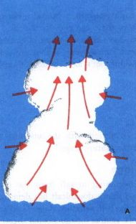
Thunderstorm Development
There are three main stages of the development of thunderstorms, and they are:
The Developing stage: Updrafts of warm air carry moisture upward. As the water vapor rises, it condenses, releasing energy to warm the air further. This allows the warm air to rise even higher. If the temperature at the upper levels is low, the warm air may rise as high as the tropopause.

Slide 5
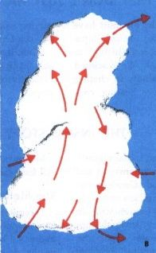
Thunderstorm Development
The Mature Stage:
The cumulonimbus cloud spreads out at the top, reaching the stratosphere in the most severe cases. Cold air containing ice, rain and sometimes hail falls downward in large downdrafts. This is the destructive part of the storm, when repeating updrafts and downdrafts produce hailstones. It is during this stage that we get thunder and lightning.

Slide 6
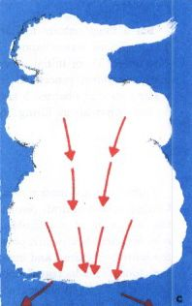
Thunderstorm Development
The Final Stage:
The downdrafts reduce the upward flow of air, and the storm weakens. Smaller clouds are seen above the lower cumulus clouds.

Slide 7
Tornadoes
What is a tornado? How are they formed?
A tornado can only form from a severe thunderstorm in which a rotating funnel cloud extends from the base of the cumulonimbus clouds to the ground.
As the rising air is replaced by coolers air at the surface, the rotation of the funnel cloud becomes faster and faster.
The rising air causes pressure difference that increases with speed. The difference in pressure can be very dangerous.
It can lift roofs off houses, vehicles, animals, trailer homes and people.

Slide 8
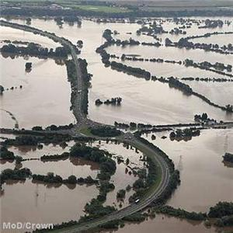
Floods
What is a flood?
A flood is an excess of water from rain, rivers, or oceans over land that cannot soak up any more water.
They can happen anywhere in the world except for Antarctica.

Slide 9
Types of floods
There are two main types of floods, and they are:
Flash floods:
A flash flood is a flood that occurs with little or no warning what so ever. This type of flood can happen in cities when water from heavy rain cannot be drained away quickly enough but it mostly occurs in mountain valleys and gorges.
The worst flood in Canadian history happened in the Saguenay area of Quebec in 1996. There was about $800 million in damages from this flood.
The worst flood in Canadian history happened in the Saguenay area of Quebec in 1996. There was about $800 million in damages from this flood.

Slide 10
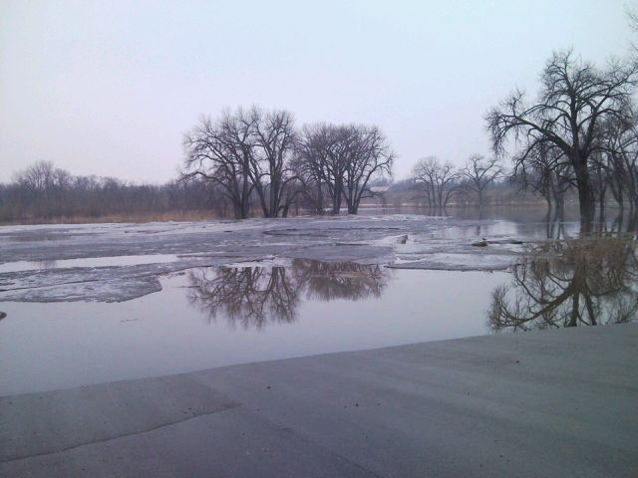
Types of flood cont.
Broadside flood:
A broadside flood covers large areas of land and can last for months. This type of flood can often be predicted days or weeks before it actually happens.
Some causes of a broadside flood is melting in the mountains where the rivers originate like the Nile River in Africa.
Some rivers flood after a winter of heavy snowfall followed by heavy rains in the spring like the Red River flood.

Slide 11
Droughts
What is a drought?
A drought is a long period of time that has much less rainfall than average. Droughts occur whenever and wherever precipitation is scarce over a long time.
The worst drought in Canada was in the mid 1930s when precipitation on the prairies was much lower than average.
During this disaster, topsoil blew off the farmland, prompting the name “Dust Blow”. The soil dried out and cracked, crops withered, livestock died and farmers went broke.
This was very devastating for most people living in the area.

Slide 12
Hurricanes, Typhoons & Tropical Cyclones
Hurricanes, Typhoons and Tropical Cyclones are very similar.
When a cyclone near the equator becomes large enough, they are then classified as a hurricane, a typhoon or a tropical cyclone depending on where they are located.

Slide 13
Hurricanes
What is a hurricane?
A hurricane is a severe cyclone that occurs in the western Atlantic Ocean, the Caribbean Sea, the Gulf of Mexico or the Western Pacific Ocean.
A very interesting fact about the word ‘Hurricane’ is that it may come from the word Hunraken which means the Mayan god of winds.
Like other storms, hurricanes are fed by convection currents.
Hurricane season can start as early as June and end as late as November.

Slide 14
Typhoons
A typhoon is a severe cyclone that develops in the northwestern Pacific Ocean or the China Sea.
The word ‘Typhoon’ comes from the Mandarin words for great wind, Tai Feng.
Typhoons can become very powerful because of their vast supply of energy from the warm waters of the Pacific Ocean.
Typhoon season is from April to December and affects areas of several countries.

Slide 15
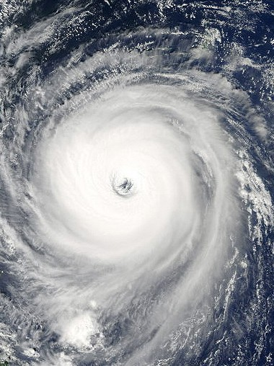
Tropical Cyclones
A tropical cyclone is a severe cyclone that develops in the Indian Ocean and the area around Australia.
Tropical Cyclones, just like Typhoons, can become very powerful because of their vast supply of energy from the warm waters of the Indian Ocean.
Tropical Cyclone season is from December to April.

Slide 16
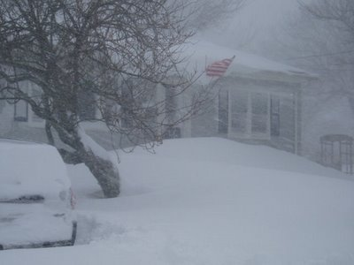
Blizzards
What is a blizzard?
A blizzard is a severe snow storm with strong winds and low temperatures.
A storm is considered a blizzard if the winds are above 55 km/h, the temperature is well below normal, and visibility is reduced to less than 0.2 km.

Slide 17
Two Causes of Blizzards
Some blizzards form the same way as a thunderstorm; however, cold temperatures bring snow rather than rain and there is barely ever any lightning.
Some of the worst blizzards develop when a warm air mass, fill with moisture from the Gulf of Mexico and the Atlantic Ocean and moves northward and meets a cold Arctic air mass under a strong jet stream.
Another cause of blizzards is the strong winds and the lake effect.
For example, in Ontario prevailing winds often bring large snowfalls to regions east of Lake Huron and Georgian Bay. Lake-effect blizzards can last for days.

Slide 18
Extreme Heat
The healthy human body functions best with an internal temperature of 37º C. any extreme conditions that make it difficult for the body to maintain its normal temperature are dangerous and may even cause death.

Slide 19
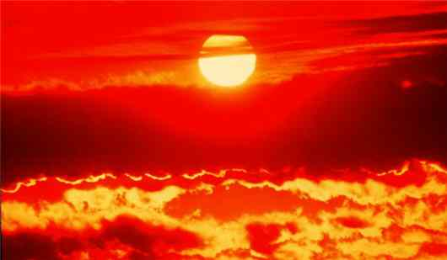
Heat Waves
What are heat waves?
A heat wave is a period of more than three days at or above 32­º C. Although a heat wave may be too hot for one person, it may be comfortable for another.
However, people with health problems, such as respiratory ailments, tend to be more susceptible than others to extreme heat.

Slide 20
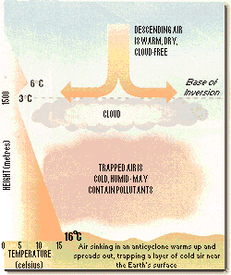
Temperature Inversions
What is a temperature inversion?
A temperature inversion is when a warm layer of air in a high-pressure system moves over and pushes down on cooler air resulting in a pocket of cold air surrounded by warmer air.

Slide 21
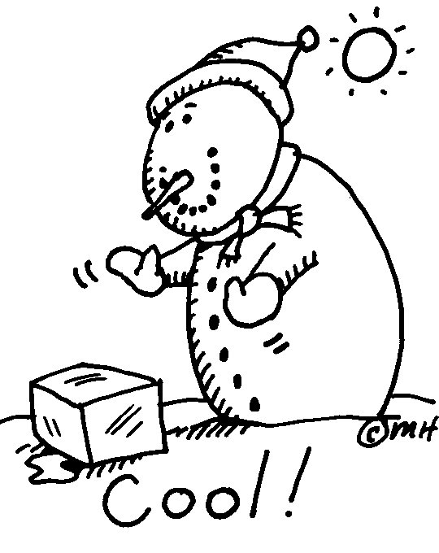
Extreme Cold
Just as high temperatures have an added factor of humidity, cold temperatures also has an added factor, which is wind.

Slide 22
Wind Chill Factor
What is a wind chill factor?
A wind chill factor is a measure of the cooling effect of wind on a body.
The wind chill temperature is more correctly called the “wind chill equivalent temperature” because it indicates what the temperature would feel like with the wind.

Slide 23
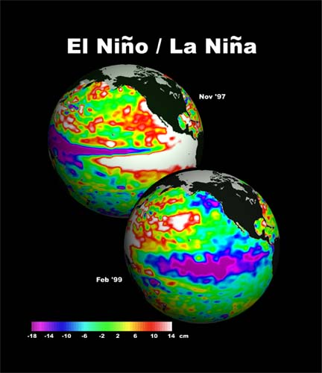
El Niño & La Niña
What do the following reports have in common?:
Toward the end of ’97, countries in the western pacific such as the Philippines that get heavy rains, suffered a severe drought.
At the same time, torrential rains fell in generally dry regions Somalia and Kenya in east Africa.
Over in the Atlantic ocean, the hurricane season was much less active the average.

Slide 24
El Niño
What is El Niño?
The answer to the extreme weather effects is due to El Niño.
El Niño is a shift in the ocean currents, temperatures, and atmospheric conditions in the tropical Pacific Ocean.
The result is a severe change in temperatures and in the weather, causing major effects on areas nearby.
El nino video
http://www.youtube.com/watch?v=fN_NmCpry38

Slide 25
El Niño
What causes El Niño?
Imagine the Pacific Ocean in a large pan, sloshing back and forth.
The el Niño effect happens when the surface water off the tropical Pacific Ocean off the coast of south America are higher than average.
The extra water begins to push eastward, reversing the equatorial current flow, and weakening the trade winds.
This is much like the water sloshing back and forth in the pan.

Slide 26
La Niña
What is La Niña?
At the opposite end of the cycle to El Niño is La Niña, which is a shift to colder than average ocean temperature in the eastern pacific.
The effects of La Niña are exact opposite to those of El Niño. This includes the increased chances of hurricanes and precipitation in places where it is usually dry.

