Slide 1
Chapter 14
Forecasting the Weather
Curtis Lawrence and Kerri Ann John
Jeffery Drew and Andrew Jeddore

Slide 2
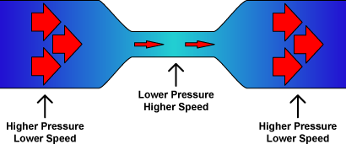
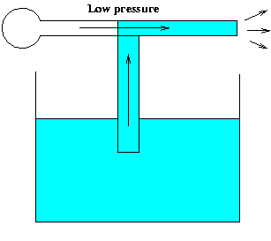
Bernoulli principle
There is a relationship between air speed and its related pressure. It states:
As the air speed increases the pressure will decrease.
Bernoulli principle states:
Where the air speed of a fluid is high, the pressure is low and where the speed of a fluid is low the pressure is high.

Slide 3
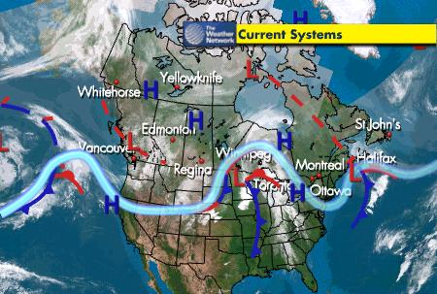
North American Weather Systems
Weather at the equator is easy to predict due the fact that the conditions do not change that often; it is generally warm and humid.
We can say the same about the weather conditions at the poles; it is generally cold and dry.

Slide 4
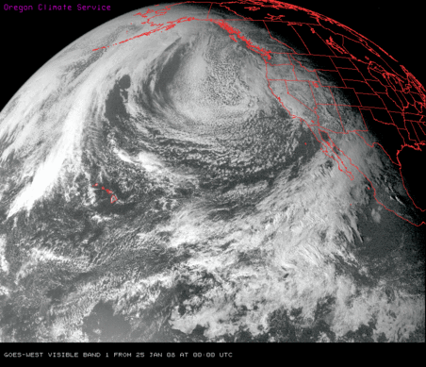
North American Weather Systems
The mid latitude regions are much more difficult to predict because the weather conditions change so often. Since we live in the mid latitudes of North America we will focus on weather and climate conditions which occur in North America.

Slide 5
A Weather System
A Weather System is a set of temperature, wind, pressure, and moisture conditions that exist for a certain region and moves as a unit for a period of days.
In the mid latitudes the prevailing winds at ground level are the Mid Latitude Westerlies. They carry weather systems consistently from west to east in North America.
In the upper atmosphere there are the jet streams which flow west to east at high speed. The reduced pressure of the fast moving air in these jet streams, due to Bernouilli’s Principle, causes air to rise upward from the earth’s surface forming low pressure areas which leads to lots of precipitation.

Slide 6
Air Masses:
An air mass a large body of air in which the temperature and moisture content at a specific altitude are fairly uniform. They may be as small as 100 km up to 1000 km across.
There are 6 main air masses that affect North America. 3 originate in the north while 3 originate at around 20-30ºN latitude. They form when the air above the ocean or land is still for several days or weeks. The air masses take on the moisture and temperature properties of the surface they are formed over.

Slide 7
Air Masses Con’t
Maritime Polar Air Masses - air masses over northern oceans they are cold and moist.
Continental Polar Air- air masses over northern land and ice and are cold and dry.
Maritime Tropical Air- air masses over oceans around 20-30oN and are warm and moist.
Continental Tropical Air -air masses that are warm and dry. These air masses affect the regional weather conditions in their respective areas.
(figure below is on page 546 in the textbook)

Slide 8
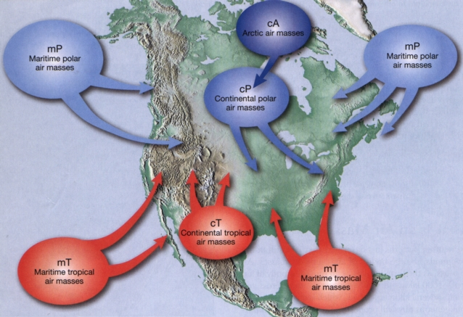
Air Masses Con’t

Slide 9
Air Masses Con’t
Since the polar air masses move south, carried along by the prevailing polar easterlies, and the tropical air masses move north, carried by the mid latitude westerlies, eventually they meet in the mid latitude regions.
This meeting of these air masses often occurs over Canada and this creates the weather systems we see on a day-to-day basis.

Slide 10
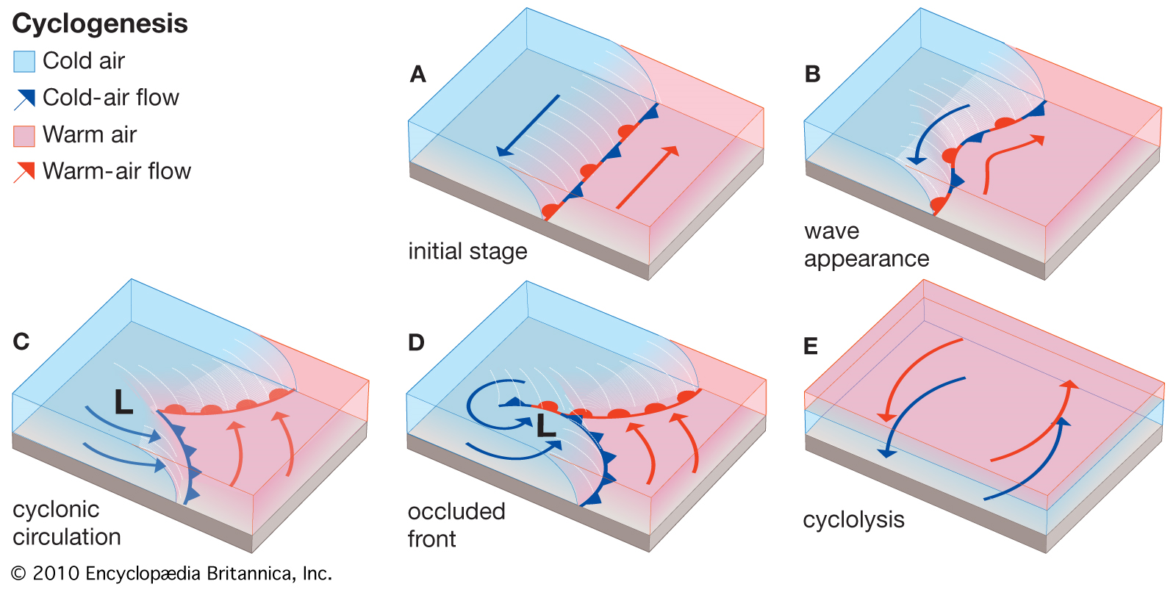
Low Pressure Systems
How does a low pressure system form?
When a warm air mass coming from the south comes in contact with a cold air mass from the north the two masses of air do not mix well so a front or boundary forms between them. This front is not moving at this time. (See page 547 in text)

Slide 11
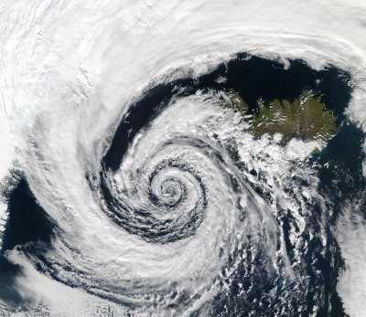
Low Pressure Systems con’t.
High up in the atmosphere air in the jet stream above the front is moving very rapidly west to east. This causes a reduced pressure in this air according to Bernoulli’s Principle. This causes air to rise upward from both air masses along the front below creating a low-pressure region near the ground.

Slide 12
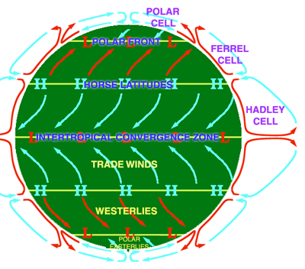
Low Pressure Systems con’t.
Air starts moving in from the regions all around this low-pressure. These winds get bent to the right in the Northern Hemisphere due to the Coriolis Effect which causes a counterclockwise motion of air over the whole low pressure region

Slide 13
What happens at the front where the warm and cold air masses meet?
Along the front below the center of the low pressure system the cold air is moving counterclockwise and pushes under the warmer air forming a cold front.
This causes the warm air to rise rapidly forming a lot of cumulonimbus clouds that results in lots of precipitation
Along the front above the center of the low pressure system the warm air moving counterclockwise rises over the cold air mass forming a warm front. This rising warm air brings moisture and precipitation with it

Slide 14
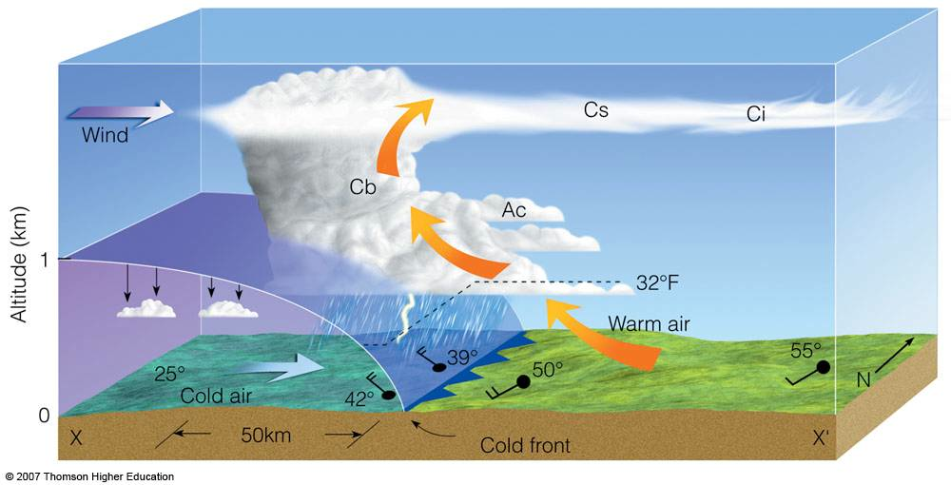
Cyclogenesis – Occluding Front
.

Slide 15
What happens at the front where the warm and cold air masses meet? Con.
Since the cold air moves faster than the warm air, the cold front begins to catch up to the warm front as they circulate counterclockwise.
This forms a single front called an occluded front.
The weather system weakening as the flow of air upward from the low-pressure area stops.
These counterclockwise swirling masses of air in the northern hemisphere are called cyclones. The process of creating a cyclone is cyclogenesis

Slide 16
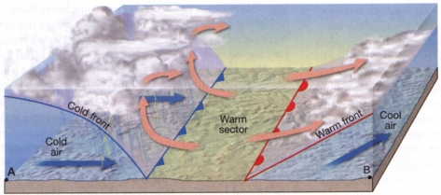
Stationary Fronts:
A stationary front occurs when the boundaries between the warm and cold air masses is are not moving and are not influenced by the jet stream. Blue Triangles (cold front) and Red Semicircles (warm front) on opposite sides of a line on a weather map indicates a stationary front.
A stationary front will remain stable until the faster moving jet stream air pulls up the air. Then it may form a low pressure system.

Slide 17
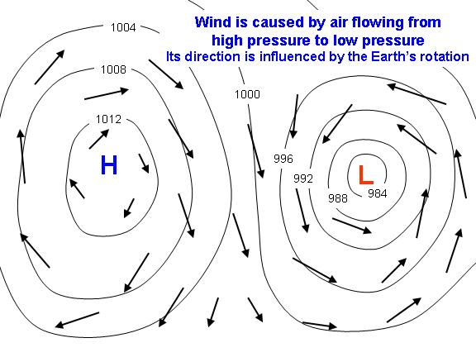
High-Pressure Systems:
In areas where air is falling anticyclone or high-pressure system forms.
When the falling air hits the earth’s surface it moves out from the center.
In the northern hemisphere these outward flowing winds are bent right which sets up a clockwise rotation of the air.

Slide 18
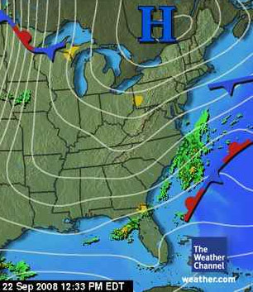
High-Pressure Systems:
These masses of falling air occur in the polar regions and they bring clear cool weather to many parts of Canada, especially in winter.
Falling air around 30ºN latitude form warm high pressure systems which can bring us clear dry weather occasionally, especially in summer.

Slide 19
Thermals
When the sun’s radiant energy warms the land the air above it gets warmed. This warm air expands and rises and other air moves in to replace it.
This rising convection current of air is called a thermal.
Thermals are weakest during early morning or late afternoon because the sun’s angle is low and the area receives less energy.
When the sun is highest in the sky at mid-day they are strongest.

Slide 20
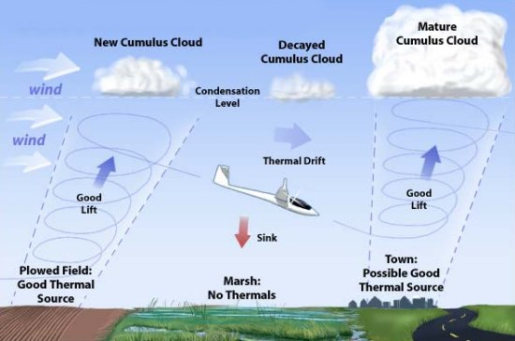
Thermals
Under extreme daytime heating of very humid air occurs the strong thermal updrafts can lead to convection-air-mass thunderstorms.

Slide 21
Sea Breeze
Solar energy warms up the land faster than the oceans creating thermal updrafts over the land which leave lower pressure areas behind. If this land is near an ocean air flows off the water causing a sea breeze.
In summer the water is cooler than the land and this sea breeze brings cooler air to coastal regions.

Slide 22
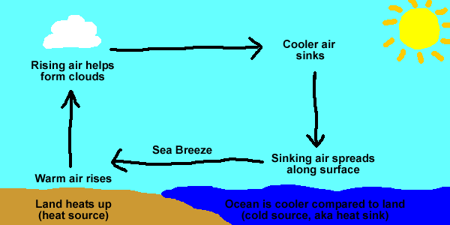
Sea Breeze
Coastal areas of NL have cooler summers and warmer winters than inland areas.
In winter the water is warmer than the land therefore the sea breezes bring warmer air to the coastal areas.

Slide 23
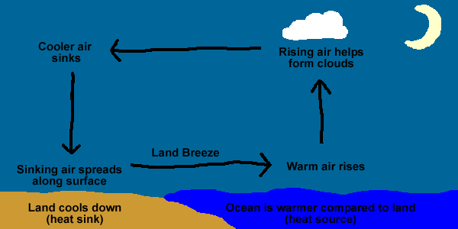
Land Breeze:
These are the reverse of sea breezes. When the sun goes down the land cools faster than the oceans. Then air above the water rises and is replaced by air blowing from the land. This is known as a land breeze.

Slide 24
Lake Effect Snow:
In winter water is warmer than land. As air blows across a large body of warmer water it picks up moisture.
When the air reaches the cold land on the other side of the water it cools and drops its precipitation in the form of snow.
This snow is called lake effect snow. Eg. Cold artic air flowing across the Great Lakes brings more snow to the US sides than the Canadian side.

Slide 25
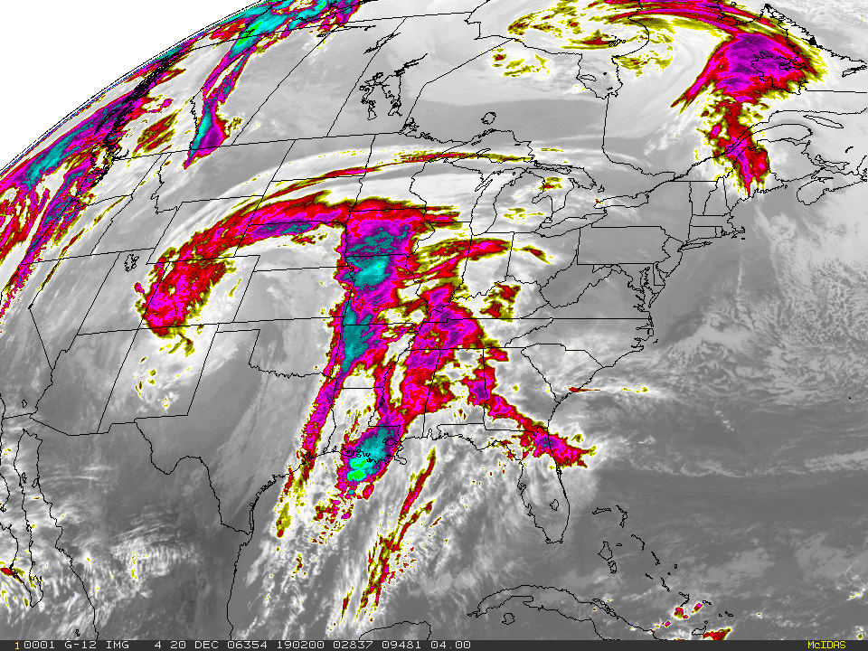
14.5 Precipitation
-Water that reaches the ground as either a solid or a liquid is precipitation.
What form it falls as depends on the temperature of the air and ground.
The different forms are:
Drizzle
Rain
Freezing rain
Ice pellets (sleet)
Snow (wet and dry)
Hail

Slide 26
Drizzle
Drizzle is a fine water droplet between 40 µm and 0.5 mm in diameter. Can be light, moderate, or heavy.
Rain:
Rain consists of falling water with a diameter between 0.5 mm and 5 mm. It can also be light, moderate, or heavy.

Slide 27
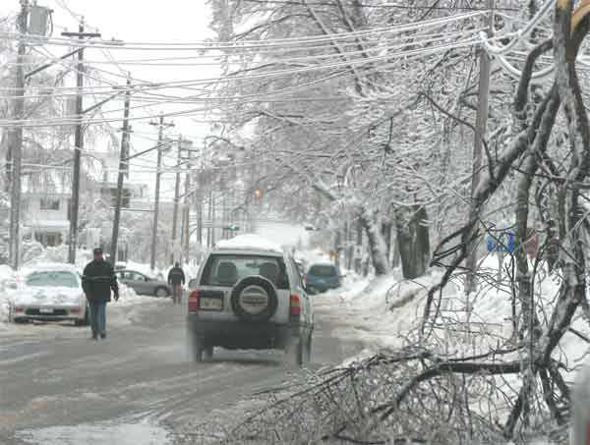
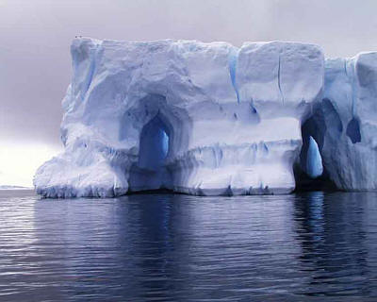
Freezing Rain:
When raindrops that are close to the freezing point of 0ºC strike a cold object on or near the ground they freeze instantaneously.
Ice Pellets: (Sleet)
This is a solid form of water. They form when snow falls through a region of warm air that partially melts it and then it falls through a colder region of air and refreeze. These ice pellets are hard enough to bounce off the ground when they strike.

Slide 28
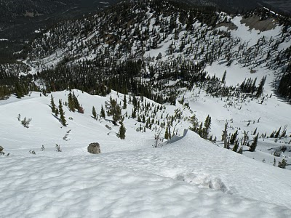
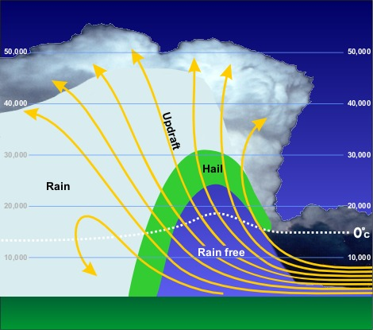
Snow
Snow forms when water droplets crystallize on dust particles in air at temperatures less than 0ºC. These ice crystals grow and combine to form snowflakes. If the temperature remains cold the snow falls to the ground as dry snow. If it falls through warmer air wet snow falls.
Hail
Hail is a solid form of water that is created in cumulonimbus clouds high in the troposphere. Frozen raindrops move up and down in highly active thunderclouds and after each cycle they add another layer of ice and become larger. They will remain suspended in the air currents until they become too heavy and fall to the ground.

Slide 29
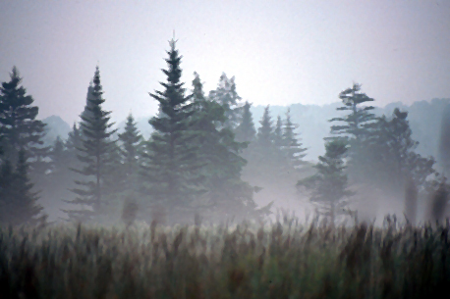
Dew
Dew forms when the moisture in the air condenses on a cool surface like the grass in the early morning. If the surface is below freezing the water vapor sublimates resulting in frost.

Slide 30
14.6 Humidity:
Humidity or Absolute Humidity is the measure of water vapor that is in the atmosphere.
If the humidity is low we feel comfortable but if it is high we find that there is no way to keep cool because the air is saturated with water vapour and water can no longer evaporate from your skin.
Clouds formed when the humidity is low generally evaporate quickly but if they form when the humidity is high they will linger for a very long time.

Slide 31
Relative Humidity:
Relative humidity is the measure of the amount of water vapour actually in the air as a percentage of the maximum amount of water vapour the air could hold at that temperature. See table below for the grams of water vapour in 1 kilogram of air when the humidity is 100%.

Slide 32
Figure 1:
Using the data in this graph the amount of water vapor in air at different % humilities and temperatures can be calculated

Slide 33
Saturated Air
Saturation of air occurs when its relative humidity is 100%. The air is holding the maximum amount of water vapour it can at that temperature.
Unsaturated air can become saturated if the air cools, eg. rising air, or when more moisture is added.

Slide 34
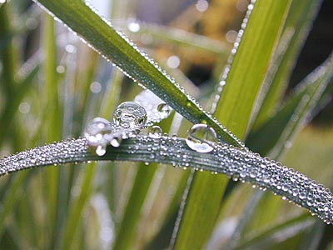
Dew and the Dew Point:
Dew forms when the air reaches its saturation temperature and the relative humidity becomes 100% - this is called the dew point.
During the day the ground absorbs energy quickly, and a night it looses this energy equally as fast. When the temperature of the ground or other objects are at or below the dew point the water vapor in the air next to it condenses out as droplets

Slide 35
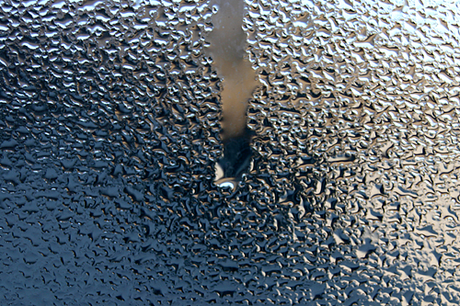
Cont…
When the skies are cloudy the earth radiates energy and the clouds absorb it, the clouds in tern radiates the energy back to the ground. That is why dew forms mainly on nights when the skies are clear.
Steam on a bathroom mirror or water on the outside of a cold glass forms in the same way as dew.

Slide 36
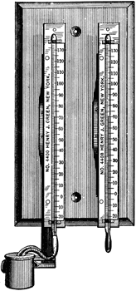
Determining Relative Humidity:
To determine relative humidity you would use a psychrometer - an instrument that uses two thermometers, one with a dry bulb and open to the air the other with a bulb made wet by covering it with wet gauze.
At relative humidity of less than 100% the water in the gauze will evaporate and take energy from the wet bulb making its temperature less than that of the dry bulb. The drier the air the greater the evaporation rate and the greater the temperature difference between the wet and dry bulbs. By knowing the dry bulb temperature and using the table below the relative humidity can be found

Slide 38
Cont…
To operate the device simply wet the gauze and then spin it. After a few minutes check the temperature of both thermometers. In general the temperature of the wet thermometer will be lower than the dry one. Subtract the wet thermometer value from the dry one and then use the table to determine the relative humidity.
Eg. The air temperature is 22⁰C and the wet bulb temperature is 17ºC. What is the relative humidity?
The temperature difference is 22 – 17 = 5ºC From the table above the relative humidity at 22ºC and a 5ºC difference is 61%.

Slide 39
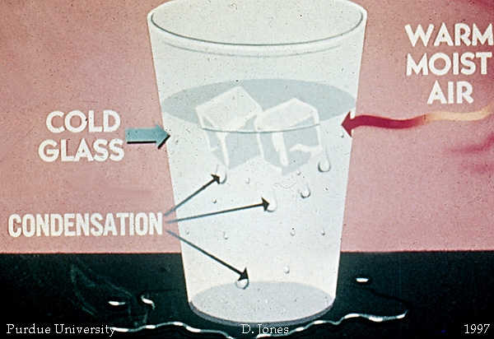
Effects of Humidity:
The amount of humidity in the air affects many things such as frost or dew forming on the ground in the early morning.
It also affects how we feel. In winter when the air is dry we find that our skin dries out very quickly because evaporation occurs.
In the summer the humid air makes it very uncomfortable for us because evaporation does not occur.

Slide 40
Weather Forecasting Technology:
Today weather forecasting is accurate for about three days.
This is due to the technology and methods we now use for gathering weather information.
There are a number of things that haven’t changed but computer technology has allowed us to generate better and more accurate models of how weather systems will move.
Things such as forecasting temperature, wind speed, atmospheric pressure, and humidity have remained the same. The main difference with these items is our ability to get this information distributed quickly to those who need it.

Slide 41
Cont…
Weather satellites and aircraft have greatly improved our ability to collect data.
Satellites travel at a height of 36,000 km and follow geosynchronous orbits.
Other satellites travel closer to the earth (1000 km at the poles).
The combined efforts of all these satellites provide a comprehensive image of the earth’s weather patterns.
Low level satellites travel around the poles every two hours collecting data such as infrared and microwave energy.

Slide 42
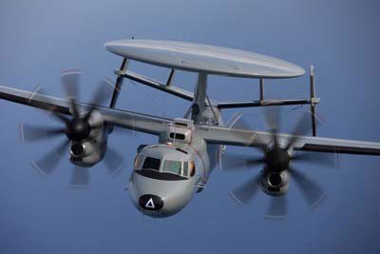
Cont…
This helps detect changes to the air temperature and water vapor in the atmosphere.
High level satellites detect electromagnetic radiation from various levels of the atmosphere, provide images of large areas (pictures of clouds), and infrared heat images
Specially equipped aircraft fly at altitudes of 20 km and collect data on ice crystal formation, wind speed of high altitude air currents, temperature, cloud heights and turbulence.

Slide 43
Cont…
Weather balloons (helium filled) collect weather related data as they rise through the troposphere.
This data is constantly being collect from transmitters on the balloons and fed into computers for analysis.
They collect information similar to aircraft but reach altitudes of 30 km.
Ground based technology such as weather stations and portable devices gather local data and it is collated and analyzed to provide information about ground level weather conditions across the country.

