Slide 1
Chapter 13 Global Weather Dynamics
Jesse Benoit & Hailey Drew
Chelsea Stride & Freda Hinks

Slide 2
The Earth:
The earth is tilted on a rotating axis by 23.5º (the axis is a line from N to S pole).
Earth revolves around the sun in an elliptical path.
70% of the earth’s surface is water. 320 million cubic miles.
30% is land with varying landforms.
Has an atmosphere that contains air, water vapor, particles of dust and chemicals.

Slide 3
Weather and Climate:
Weather – is a set of environmental conditions encountered from day to day.
Eg. A week’s weather in St. John’s in January could be mild, rainy, with a temperature of 2^{O}C
Climate – is a set of environmental conditions averaged over many years.
Eg. The climate in St. John’s in January is cold, snowy, windy, with an average day time temperature of -5 ^{O}C (averaged from years of data)

Slide 4
Global Geography:
Longitude – angle measured east or west of line zero that passes through Greenwich, England. (Cape Breton Island is 60^{O} West longitude)
Latitude – angle measured north or south of the equator. Canada/US border lies along the 49^{O} north latitude.

Slide 5
Earths Axis

Slide 6
Northern hemisphere
Tropic of Cancer – 23.5^{O} N latitude is the most northerly latitude reached by the sun’s vertical rays. It is reached on the first day of summer in the Northern hemisphere, approx. June 21st.
Arctic Circle – 66.5^{O} N latitude. Most northerly latitude reached by the sun’s rays on the first day of winter in the Northern hemisphere, approx. December 21st.

Slide 7
Southern Hemisphere
Tropic of Capricorn is the most southerly latitude reached by the sun’s vertical rays. It is reached on the first day of summer in the Southern hemisphere, approx. December 21st.
Antarctic Circle – 66.5^{O} S latitude. Most southerly latitude reached by the sun’s rays on the first day of winter in the Southern hemisphere, approx. June 21st.

Slide 8
World Regions
The Tropics - between the Tropic of Cancer and Capricorn.
Polar Regions - north and south of the Arctic and Antarctic Circles.
Mid-Latitudes - between the Tropics and the Polar Regions.

Slide 9
Earth’s Energy Balance
Almost all the energy necessary to sustain life and influence weather comes from the sun. Without this energy life could not exist.
Some of this energy is used by plants to grow and plants are the basic energy source for all life on earth.

Slide 10
Energy Balance
This incoming energy is equally balanced by energy leaving earth and going out into space.
This energy balance keeps the average surface temperature of the earth at about 15^{O}C, which is high enough to allow for the wide diversity of living creatures on earth.

Slide 11
Energy Balance

Slide 12
Energy transfer and Radiation
Energy transfer can occur in any of 4 different ways. They are all involved in the earth’s weather.
This is the transfer of energy by waves.
This is the only type that does not require a medium like air or water to carry the waves.

Slide 13
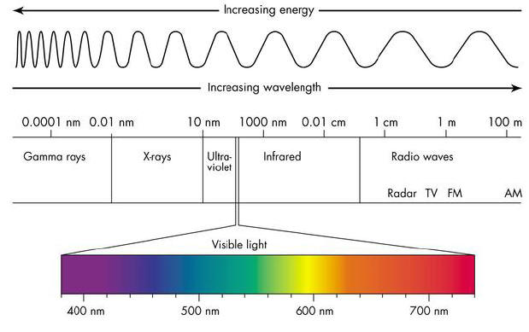
Electromagnetic Spectrum
They can travel through space therefore this is the method by which the sun’s energy reaches us here on earth.
There are many forms of radiant energy that reaches us (note the electromagnetic spectrum in the text p. 504). Eg. Visible light, microwaves, infra-red, ultraviolet, X-rays

Slide 14
Conduction and convection
Conduction: Conduction is the transfer of energy through the collision of particles in a solid It occurs most easily through metals but to a lesser extent in other substances. Eg rock, soil, water
Convection: Transfer of energy in a liquid. This liquid could be either a gas or water. The energy in convection is transferred vertically.

Slide 15
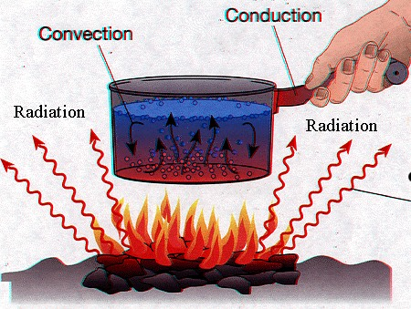
Radiation, Convection, Conduction

Slide 16
Advection
Advection: Transfer of energy in a liquid. This liquid could be either a gas or water. The energy in advection is transferred horizontally
All of these methods are important in understanding how weather systems operate and it is through these methods of energy transfer that help maintain the earth’s energy balance and distribute energy around the world.

Slide 17
Reflection and Absorption of Energy:
What happens to the radiant energy from the sun that reaches the earth? Fig. 4, p. 506
27% is reflected by clouds and never reaches the earth’s surface.
3% is reflected off the earth’s surface back into space.
The land and oceans absorb 50% of the sun’s energy.
The clouds absorb 20% of this energy.

Slide 18
Continued
Much of the energy that reaches the earth is reflected back and some is absorbed. How much is reflected back depends on the albedo of the material the radiant energy hits. (albedo – ability to reflect radiant energy). Eg. White snow – high albedo, Black soil – low albedo
Objects that absorb energy and become warmer are known as heat sinks. Some materials are better than others.
Example – water is better than land at absorbing, and retaining heat energy.

Slide 19
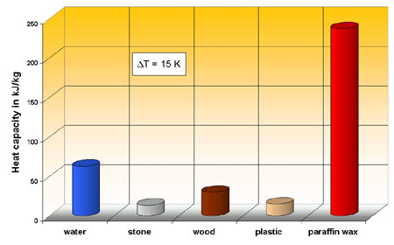
Heat Capacity
How good a heat sink a substance is depends largely on its heat capacity.
Heat capacity – a measure of how much heat energy it must absorb to increase its temperature or how much energy it lost when it decreases in temperature. Fig. 5, p. 506

Slide 20
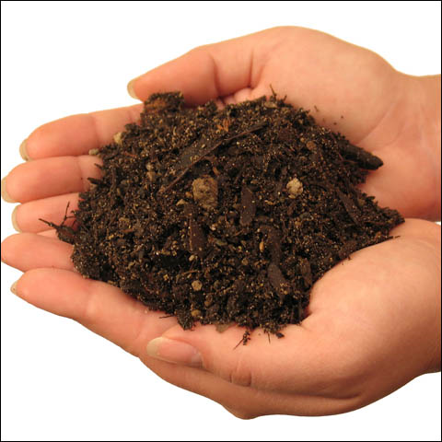
Heat Sinks
Soil and rock are poor heat sinks – low heat capacity
Water is a good heat sink – high heat capacity because it can hold a lot more heat. Because of this large bodies of water greatly affect weather and climate.

Slide 21
Seasons.
Seasons and the Angle of Sunlight: Our changing seasons and the resulting weather changes depend upon the Earth’s revolution around the sun combined with the tilt of the earth’s axis. Fig. 1, p. 508
Summer Solstice: Occurs around June 21 and it occurs when the northern hemisphere has summer and it is winter in the southern hemisphere. The earth is tilted towards the sun. The Sun is over the Tropic of Cancer. The longest day of the year in the northern hemisphere.

Slide 22
Winter Solstice
Winter Solstice: Occurs around December 21 and it is winter in the northern hemisphere and it is summer in the southern hemisphere. The earth is tilted away from the sun. The sun is over the Tropic of Capricorn. The shortest day of the year in the northern hemisphere.
Vernal Equinox: Occurs around March 21 and it is spring in the northern hemisphere Sun hits the earth at the equator. Equal length day and night.

Slide 23
Autumnal Equinox
Occurs around September 21 and it is fall in the northern hemisphere Sun hits the earth at the equator. Equal length day and night.

Slide 24
The Seasons

Slide 25
Atmosphere
The Atmosphere: the blanket of air and moisture that surrounds the earth.
The atmosphere’s composition
78% Nitrogen
21% Oxygen.
1% are other gases
(Carbon Dioxide, Argon, Neon, Helium, Krypton, Hydrogen, and Ozone.
Air also contains water vapour which can be as high as 3% at sealevel.
The atmosphere has a number of layers each with its own properties. As the altitude (distance above sea-level) increases we move into these different layers
It is most dense at sea level because of the pressure of pushes the molecules closer together.

Slide 26
The Troposphere:
Layer closest to the earth’s surface it extends to an altitude of about 16 km at the equator and about 8 km at the poles The atmosphere is thicker at the equator than at the poles due to the warmer temperatures which causes the are to expand and to the spinning of the earth on itsaxis. The temperature is from 15ºC at the surface to -50ºC at the top.
It contains most of the atmosphere’s moisture and is responsible for our weather patterns.

Slide 27
The Tropopause
This is a very thin layer that separates the troposphere from the stratosphere. Here the temperature increases rather than decreases due to the amount of ozone, which absorbs more ultraviolet radiation and therefore increase the temperature.
This increased temperature in the Tropopause is important because the higher this temperature the more separation there is between the troposphere and the next layer.

Slide 28
The Stratosphere:
This layer contains very little moisture and extends for some 50 Km. It exists from about 12 Km to 50 Km. It contains more Ozone than any other layer.
Ozone is the gas which absorbs most of the ultraviolet radiation from the sun and prevents it from reaching the earth’s surface where it can cause great damage to living creatures.
The temperature in the stratosphere increases rather than decreases to a value of approx. 10 degrees C.

Slide 29
The Mesosphere:
This is the middle layer (meso – means middle) of the earth’s atmosphere. Concentration of this layer is similar to the others with the exception of a lack of ozone and water vapor.
The temperature in the mesosphere is very cold reaching as low as -75 degrees C. The density of the gases at this level is very low, and this layer extends from about 50 to 80 km.

Slide 30
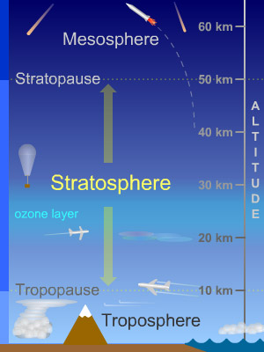
Exosphere and Stratosphere

Slide 31
The Thermosphere:
As its name implies the temperature in the thermosphere is much higher. Its average temperature is around 30 degrees C. This increased temperature is due to the fact that this layer absorbs x-rays (the highest energy electromagnetic radiation).
It is also called the ionosphere because the radiation from the sun causes the molecules to become ionized. This produces the auroras, the northern lights and southern lights. This layer extends from 80 to 500 km.

Slide 32
Exosphere:
Very thin outer layer where there is almost no atmosphere at all. The most common element in this layer is hydrogen. The temperature is cold and it can be called outer space.
Notice that in each layer the temperature will either increase or decrease. The change in temperature over a distance is known as a temperature gradient.
Eg. The temperature gradient for the troposphere is about -6 ºC for every 1000 metres.

Slide 33
Supporting Life on earth
The atmosphere makes life possible because:
Oxygen and Nitrogen in the atmosphere are needed to support life.
Carbon Dioxide is needed for green plants. Ozone (in the upper atmosphere) absorbs UV radiation which prevents the burning of plants and animals.
It plays an important role in the water cycle – all organisms require clean water.
It protects the earth’s surface from meteors, most will burn up as they enter the atmosphere.
It regulates temperature by keeping the average temperature within a life supporting range because water vapor and gases like carbon dioxide trap energy during the day and release it slowly during the night.
The air circulates around the globe and helps maintain a fairly constant balance.

Slide 34
Atmospheric Pressure:
- is the pressure the air exerts as gravity pulls it towards the center of the earth.
It is greatest at sea level since the height, and therefore weight, of the atmosphere is greatest. As altitude increases, for example climbing up a mountain, the height of the atmosphere decreases, which means the weight of the air above is less and pressure is less.
Other factors which affect atmospheric pressure is whether the air is rising or falling. Rising air has less pressure than falling air.

Slide 35
Atmospheric pressure

Slide 36
Aneroid Barometer
Atmospheric pressure or barometric pressure is measured with a Barometer - an instrument that detects the changes in the atmospheric pressure.
The most common type of barometer is called an aneroid barometer - a sealed chamber with flexible sides (or an aneroid cell) connected to a scale. The term aneroid refers to the fact that it does not use water to help determine pressure. It is sensitive to changes in the atmospheric pressure. Fig. 5, p. 512

Slide 37
Atmospheric Pressure
Pressure is measured in KPa (Kilopascals)
Standard Atmospheric Pressure is the normal atmospheric pressure at sea-level. It is assigned a value of 101.3kPa.
Low Pressure weather systems have atmospheric pressures less than 101.3kPa.
High Pressure weather systems have atmospheric pressures greater than 101.3kPa.
Pressure Gradient - A measure of the amount the atmospheric pressure changes across a set distance.

Slide 38
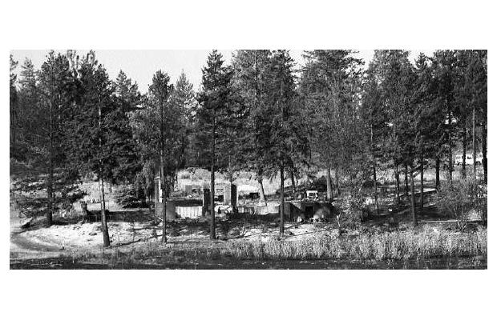
High winds. Low winds.

Slide 39
Prevailing Wind Patterns:
The winds are one of the most important features when discussing weather.
Wind - the movement of air in the atmosphere.
Some winds are local while others are prevailing.
Local winds – occur in a fairly small region.
Prevailing winds – affect large areas of the earth.

Slide 40
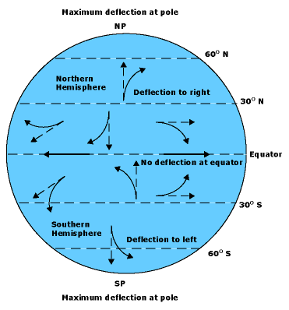
Corolis Effect
In any rotating system anything that moves long distances appear to change direction.
http://www.youtube.com/watch?v=mcPs_OdQOYU

Slide 41
Prevailing Winds
Points on the earth at different latitudes to be moving west to east at different speeds.
A person standing on the equator, where the earth’s circumference is 40000km, is traveling west to east at approximately 1700km/h
A person at 60º north latitude, where the earth’s circumference is only 20000km, is traveling west to east at only approximately 850km/h.
The earth’s rotation underneath its own atmosphere causes a Coriolis Effect in the atmosphere resulting in special wind directions in the northern and southern hemispheres.

Slide 42
Prevailing Winds
In the northern hemisphere, The Coriolis effect causes winds to twist to the right of the direction of flow.
In the southern hemisphere, The Coriolis effect causes winds to twist to the left of the direction of flow.
Causes of Prevailing Winds:
There are combinations of things that cause prevailing winds. They are:
Convection currents set up in the atmosphere
Earth’s west to east rotation

Slide 43
Convection Currents

Slide 44
Jet Streams
Jet streams occur about 7000m up in the troposphere. There are 2 in the northern hemisphere and 2 in the southern hemisphere that stretch all the way around the earth.
The atmosphere is thicker at the equator than at the poles. At the equator, where the troposphere is about 14000m thick, at an altitude of 7000m there is still another 7000m of atmosphere above this point therefore the atmospheric pressure is relatively high.
However at 30º north latitude, where the troposphere is only 12000m thick, there is only 5000m of atmosphere above the 7000m altitude which results in lower atmospheric pressure.

Slide 45
Jet Streams.

Slide 46
Effects of Prevailing Winds:
They help to distribute large amounts of energy around the globe. For example in the northern hemisphere warm air flows north carrying energy and colder air flows south.
They also carry moisture that helps to distribute a variety of precipitation types around the world. Remember – rising air is warm and moist while falling air is cool and dry

Slide 47
At The Equator
Near the equator, where two sets of convection currents meet (from north and south hemispheres) and rise weather tends to be cloudy and rainy.
At about 30⁰ N latitude the falling air is very dry and we get desert conditions.
At 60⁰ N latitude, two air systems meet and rise and again this produces more rain and cloudy conditions.

Slide 48
At The Polar Regions
In the Polar Regions the air pressure is greater and the air colder and more dense. This produces faster falling air, higher pressure systems, and the great temperature differences between these polar regions and regions further south. This results in very large pressure gradients and stronger winds. Also the Polar Regions have much less precipitation than expected.

Slide 49
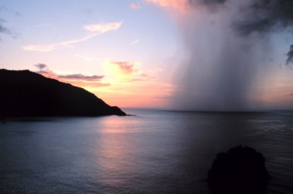
The Hydrosphere
The hydrosphere - all the water that exists on the planet. It includes water in the oceans, lakes, rivers, underground, trapped in glaciers, and in the atmosphere. It covers 70% of the earth’s surface. 320 million cubic miles.

Slide 50
Water Distribution
95.5% of the earth’s water is salt water contained in the oceans.
Of the remaining 4.5% is fresh water and is distributed as follows:
Glaciers and polar ice caps 87.3%
Underground water 12.3%
Surface and atmospheric water 0.4%.
This supply is further divided as follows:
Lakes 90% Atmosphere 9% Rivers 1%

Slide 51
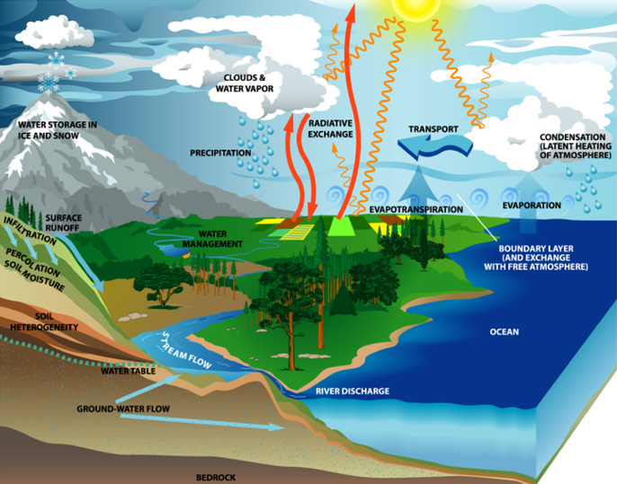
The water cycle
Energy from the sun causes the surface water to change state from a liquid or a solid into a vapour which is carried into the upper atmosphere by rising air. Evaporation is the conversion of liquid water liquid into a gas; sublimation is the change of solid water (ice / snow) into a gas without first converting into a liquid.

Slide 52
Water cycle continued…
As the vapor rises the pressure and temperature decrease which cause it to condense into fog, mist, and/or clouds.
In some cases the water vapor may form ice crystals before becoming water. This is called deposition (opposite of sublimation)
The resulting precipitation (rain, snow, hail, sleet) falls to the ground where it either flows over the earth’s surface (run-off) or it soaks into the soil and becomes groundwater.
In this way water is recycled the world over.

Slide 53
Major Ocean Currents…
Oceans play a very important role in the weather dynamics of the earth because they are so vast and act as a good heat sink.
At the equator there is very little land mass all around the earth and that is where the suns rays are most direct. Since water has a very high heat capacity it can absorb huge amounts of energy near the equator
This heated surface water and the earth’s rotation causes huge equatorial east to west ocean currents.
When these currents collide with continents they flow north and south along the east coasts of these continents.
This moves tremendous amounts of energy north and south away from the equator.

Slide 54
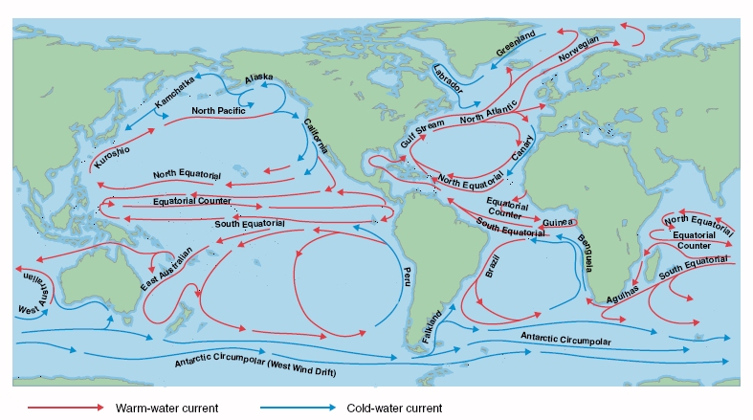
Ocean Currents continued…
This warm equatorial water is replaced by colder waters flowing from the north and south Polar Regions along the west coasts of these continents.

Slide 55
Causes of ocean currents…
The ocean currents have very distinct patterns, which are caused by a number of things:
Convection currents.
Winds across the oceans.
The earth’s rotation.
Shape of the continents.
Heat capacity of water and the amount of salt in the oceans.

Slide 56
Causes Continued…
Warm water rises, expands and moves away from the equator towards the north and south poles while cold water in the north tends to sink and migrate towards the equator.
At the equator, where the prevailing winds are easterly, and the tendency of the flowing waters to be deflected by the Coriolis Effect, the currents always flow from east to west.

Slide 57
Effects of Ocean currents…
There are many effects as a result of the ocean currents:
Warming currents keep northern harbors free of ice in the winter.
Cold currents that reach land on the west sides of continents have dry air above them cause desert climate conditions.
Areas like the coast of Peru and the west coast of Africa get very little rain because of this.
Warm currents that reach land on the east sides of continents have warm, moist air above them. This causes rain forest climate conditions in equatorial regions along these coasts.

Slide 58
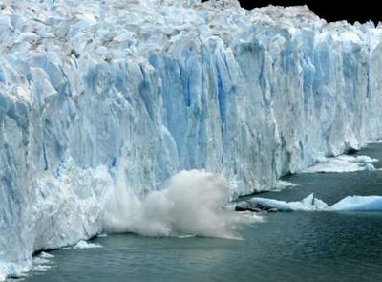
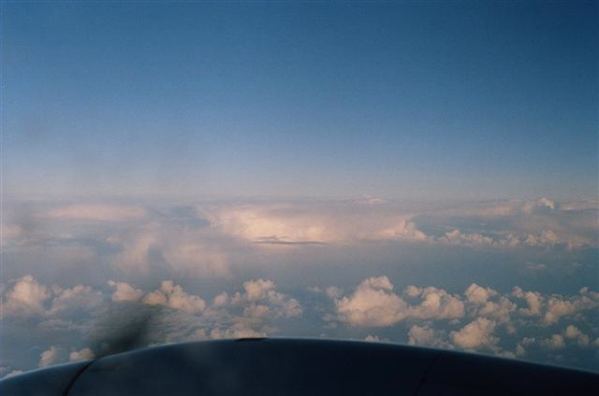
Some effects of Ocean Currents…

Slide 59
Clouds and Fog…
As the air warms water vapor causes the moisture in the ground, and water to evaporate.
Once it rises into the atmosphere it cools and condenses into clouds
Not all clouds will produce rain or snow because the droplets that make up the clouds are so small and are easily suspended by the atmosphere.
There needs to be thousands of these droplets combine before precipitation will occur.

Slide 60
Formation of Clouds..
There are 3 categories that cloud formation can be classified. They are:
Convection Clouds
Where air near the ground absorbs energy from heated surfaces and starts to rise because it is warmer and less dense. The rising warm air carries water vapor up into the atmosphere. At higher altitudes the air pressure is thinner and the gases expand and cools because the particles loose energy as they move further apart. The water vapor also cools and condenses forming clouds.
Frontal Clouds
Form where the leading edge of a large moving mass of air meets another mass of air at a different temperature. Warm air masses generally are less dense and contain more moisture than cold air masses. Also, warm air rises over, or is pushed upward, by colder air. The rising warm air expands, cools and the water vapour it contains condenses to form clouds.

Slide 61
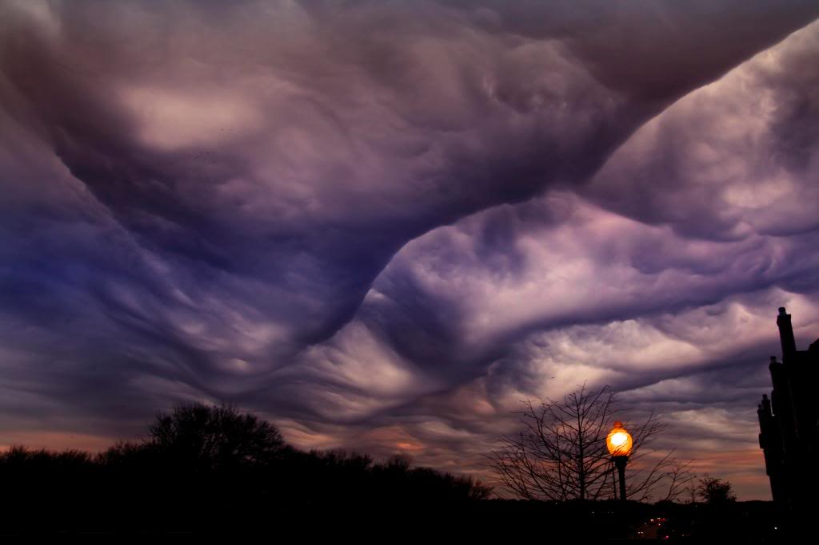
Continued....
Orographic Clouds
Clouds that form as warm, moist air moves up a mountain the pressure decreases and the temperature decreases thus causing a the mountain leaving the peak in sunshine

Slide 62
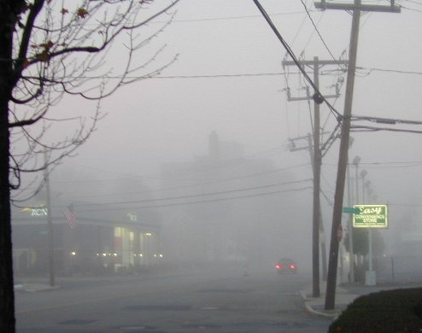
Fog
Fog is actually a cloud that forms near the ground. There are a number of different kinds:
When energy near the surface radiates upward but is not reflected back to earth by clouds. The air near the ground cools allowing the water vapor to condense into fog.
When warm air passes over snow. A sharp decrease in the temperature of the warm air causes the moisture to condense and form fog.
When warm ocean air meets either cold ocean currents of colder air at the shoreline. This is the type of fog we find here in NF

Slide 63
Classification of Clouds
Clouds are divided into two main groups
Cumulus clouds
Have a billowing rounded shape
Derived from the word mean heap
Grow vertically usually indicating unstable weather
Stratus clouds
Flattened layered shape
Grow horizontally
Derived from a word meaning spread out
Created from a warm air front over rides a colder air mass
Generally indicate stable weather

Slide 64
Rules for Naming Clouds
Names are given according to their altitude
Low level clouds have the simple names cumulus and stratus
Medium level clouds have the prefix alto, meaning higher
High level clouds have the prefix cirrus, meaning curly lock of hair
Rain holding clouds are called nimbus

