Slide 1
Chapter 19 Introducing Evolution
Part 1 By: Shannon Hinks, Mise’l Jeddore , and Stephen Quann Part 2 By: Yolanda John, Caitlin Stride, and Shelayne Walsh
May 2010

Slide 2
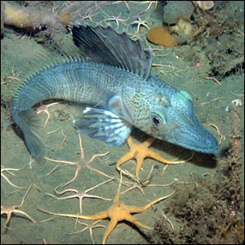
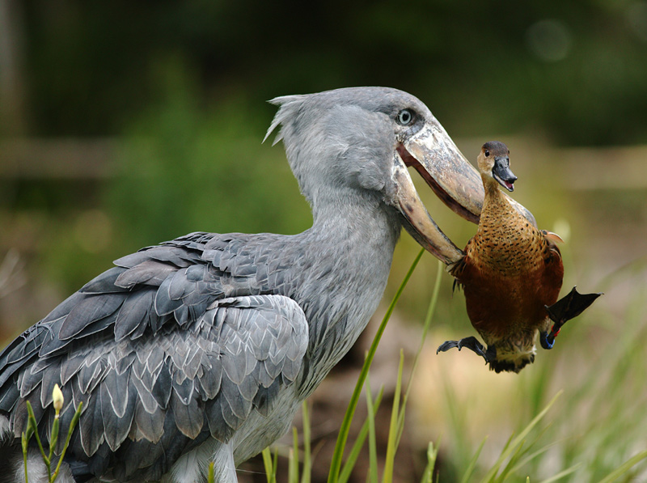
Diversity Of Life Section 19.1
Evolution refers to the relative change in the characteristics of populations that occur over successive generations.
Adaptation is a particular structure, physiology, or behavior that helps a organisms to survive and reproduce in a particular environment.

Slide 3
Con’t
There are many different adaptations within organisms on this planet. Examples include ; camouflage, a human’s thumb, an Eagle’s eyesight, etc. Adaptations help an organism survive and therefore that organism will have a better chance of passing on to its offspring the particular characteristic which was advantageous to its survival.
As well, changes in an organism’s environment can often determine whether an adaptation will or will not help an organism survive.

Slide 4
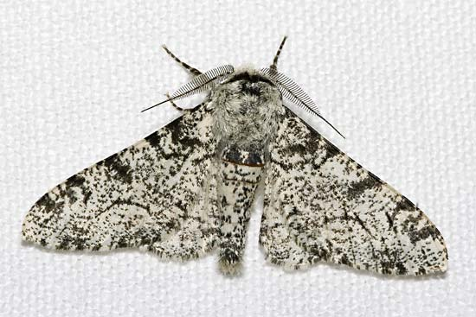
The Peppered Moth
The English peppered moth is an example of how characteristics can change in response to changes in an organism’s environment.
The peppered moth has two colors
Greyish – white with black dots
Black
In 1848, estimates determined that there were many more greyish-white peppered moths ( about 98% ) than black ones ( about 2% ). In 1898, approximately 95% of the moths in Manchester, England were of the black color with only about 5% being greyish-white.

Slide 5
Con’t
The reason for the change is due to a change in the moth’s environment.
Prior to the Industrial Revolution, the greyish-white moths were able to camouflage themselves against the light colored lichens on tree trunks while the black colored moths stood out and were eaten by predators.
Once the Industrial Revolution began, air pollution from the factories killed the lichens and soot began to cover the tree trunks. As a result of this, the greyish-white moths were easily seen by predators and eaten while the black moths could camouflage themselves, survive and pass on their genes to their offspring.

Slide 6
Con’t
The difference between the two colors of peppered moth is a single gene. Before the Revolution, more greyish-white moths survived and thus passed on their form of the gene for color to the gene pool.
Once the Revolution started, the black moths were able to survive and pass on their form of the gene. This occurred over a number of generations.
In the 1950s, due to clean air legislation, lichens began to grow on trees again. This began to change the peppered moth once again. In 1959, 9 / 10 moths were black in color. In 1985, 5 / 10 were black and by 1989, only 3 / 10 were black.
Based on the above example we can define evolution as ;
“Any shift in the gene pool of a population.”

Slide 7
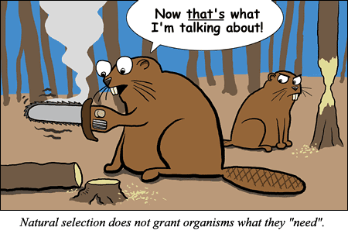
Natural Selection
Natural selection is a process in which the characteristics of a population of organisms change because individuals with certain heritable traits survive specific environmental conditions and pass on their traits to their offspring. In order for natural selection to occur there must be diversity within a species.
Because nature plays a role in selecting certain characteristics, we can say that the environment exerts a selective pressure on a population.

Slide 8
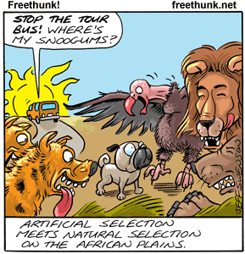
Artificial Selection
Humans have the ability to artificially select organisms for certain traits. In the process of artificial selection, a breeder selects individuals to breed for the desired characteristic which he / she wishes to see in the next generation.
As well, artificial selection can also produce characteristics which are not particularly desirable. Artificial selection is quite similar to the process of natural selection, however in artificial selection humans are playing the role of the environment by determining which traits are passed on from one generation to the next.
In natural selection, “survival of the fittest” is the rule by which traits are passed on, however, in artificial selection this is not necessarily so

Slide 9
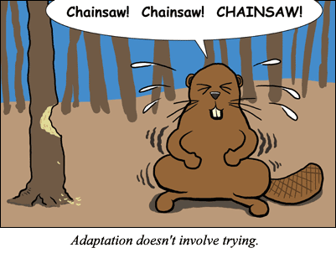
Natural Selection is Situational
Natural selection is considered to be situational.
This means that adaptations which are beneficial to an organism in one situation may be useless or even detrimental in another situation.

Slide 10
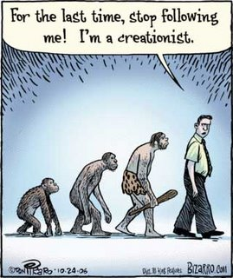
Developing The Theory Of Evolution Section 19.2
The work and ideas of many people has helped to shape our current understanding of evolution.

Slide 11
An Historical Context
In ancient times, Greek philosophers believed that life gradually evolved.
Other philosophers such as Aristotle did not support the idea of evolution and believed that all of the organisms that would ever exist were already created and would not change.

Slide 12
Con’t
In the 19th century, new ideas began to emerge including:
Living things did change during the course of history.
Organisms which exist now may be different from the organisms which existed previously in history.
Populations of organisms probably even changed from one generation to the next.
Populations contain variations and populations can adapt to particular situations.
The above ideas were contrary to the religious teachings of the time and were dismissed as hearsay.

Slide 13
Cuvier’s Fossils
Paleontology he study of fossils, provides important clues to help develop the theory of evolution.
Georges Cuvier, a French scientist, is credited with developing the science of paleontology.
Cuvier realized that the history of life on Earth was recorded in the layers of rocks which make up the Earth and these layers contained fossils.
He also found that each of the rock layers, or strata, is characterized by a unique group of fossil species and the deeper the layer, the more dissimilar the organisms are from modern life.

Slide 14
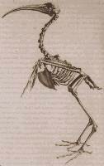
Con’t
He also recognized that the extinction of species was a common occurrence in Earth’s history.
Working layer by layer he found evidence that species appeared and disappeared over millions of years.
Cuvier proposed the idea of catastrophism to explain the appearance and disappearance of species.
This idea suggests that catastrophes such as floods, diseases, or droughts had periodically destroyed species that were living in a particular region.
Once species were destroyed in a geographical region the area would be repopulated by species from nearby unaffected areas.

Slide 15
Lamarck’s Theory of Inheritance of Acquired Characteristics
In 1809, Jean-Baptiste Lamarck published his theory of evolution.
By comparing current species of animals with fossils he could see a “line of descent” which showed a series of fossils from older to more recent modern species.
Lamarck proposed that microscopic organisms arose spontaneously from non-living sources. He also thought that species were initially primitive and began to increase in complexity over time until they achieved perfection. He believed that organisms would become better adapted to their environment over time

Slide 16
Con’t
Lamarck proposed the idea of “Use and disuse” This law states that if body parts were used extensively they would become larger and stronger. As well, if body parts were not used they would become smaller and weaker.
He also proposed the idea of “inheritance of acquired characteristics” This idea states that if an organism characteristics acquired during an organism’s lifetime could be passed on to its offspring.
Although Lamarck’s theory of evolution is now known to be incorrect, his ideas provoked much thought and discussion.
His ideas also influenced others such as Charles Darwin.

Slide 17
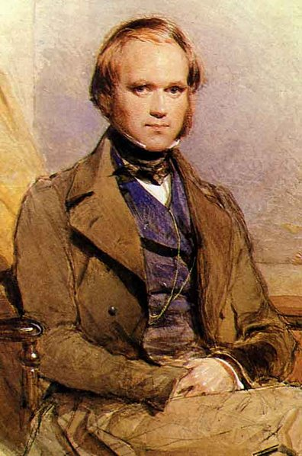
Darwin’s Evidence
In 1831, Charles Darwin began a 5 year voyage aboard a ship called the HMS Beagle. This voyage gave Darwin an opportunity to travel much of the world and explore the natural history of various locations.
Darwin gathered thousands of biological specimens and made many important observations which led him to realize how life forms change over time and vary from place to place.

Slide 18
Con’t.
Darwin made several observations:
The flora and fauna of the different regions he visited were distinct from each other.
He also noted that lands that have similar climates seemed to have unrelated plants and animals.
He also found several important fossil remains and these fossils were related to living forms.

Slide 19
More about Darwin’s Observations
While in the Galapagos Islands, Darwin observed many new species which were unique to the Galapagos. However, there were differences in organisms from island to island.
Observations of organisms such as tortoises and finches (birds) were a key to helping Darwin formulate his final theory of evolution. From his information on these two organisms Darwin demonstrated a mechanism for how new species could arise from ancestral ones in response to the local environment.
Another important influence for Darwin was a book called Principles of Geology by Charles Lyell. Lyell’s book expanded on the ideas of another geologist called James Hutton. Hutton had stated that the Earth’s geological features were in a slow continuous cycle of change.
As a result of reading this book, Darwin began to question the age of the Earth as proposed by biblical scholars who suggested that it was only 6000 years old. Darwin applied the idea of slow changes to geological features to populations of organisms.

Slide 20
Darwin’s Theory of Evolution
In 1838, Darwin read an article entitled Essay on the Principles of Populations which was written by Thomas Malthus.
From this reading, Darwin came across the idea that; “plant and animal populations grew faster than their food supply and eventually a population is reduced by starvation, disease, or war.” From this Darwin realized that individuals had to struggle to survive and only some individuals survive this struggle and produce offspring. The survivors could pass on their favorable traits to their offspring.
From these ideas Darwin began to formulate his theory which he called Natural Selection.
This theory can be summarized in the following statement:
“Individuals that possess physical, behavioral, or other traits that help them to survive in the local environment are more likely to pass these traits on to offspring than those that do not have such advantageous traits.”
His ideas were presented in 1859 in a book entitled The Origin Of Species. Darwin was the first person to gather a number of facts related to evolution and present them cohesively, thus today we consider Charles Darwin to be the father of evolution.

Slide 21
Decent With Modification
Darwin did not use the word “evolution” in his book, rather he used the idea of “descent with modification”.
The idea of descent with modification is based on two main ideas:
Present forms of life have arisen by descent and modification from an ancestral species.
The mechanism for modification is natural selection working continuously for long periods of time.
Natural selection showed how populations of individual species became better adapted to their local environments.

Slide 22
Factors Governing Natural Selection
The factors which govern the idea of natural selection include:
Organisms produce more offspring than can survive, and therefore organisms compete for limited resources.
Individuals of a population vary extensively and much of this variation is inheritable.
Those individuals that are better suited to local environmental conditions survive to produce offspring.
Processes for change are slow and gradual.
Although we do consider Charles Darwin to be the father of evolution, the work of Lyell, Lamarck, and Cuvier also helped to shape our understanding of evolution.

Slide 23
Evidence of Evolution Section 19.3
Evidence for this theory has come from:
The fossil record
The sciences of Genetics and Molecular Biology
The geographical distribution of organisms on Earth
Studies of the anatomy of animals
Studies of embryonic animals

Slide 24
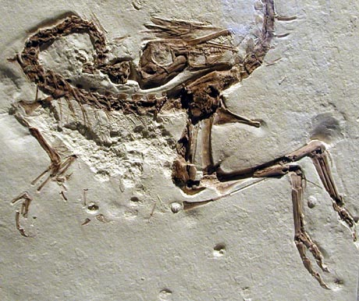
1. The fossil Record
A fossil is made when organisms become buried in sediment which eventually converts itself into rock.
From our study of sedimentary rocks which contain fossils scientists have created a fossil record of the history of life on Earth.
This record shows the kinds of organisms that were alive in the past.
Some fossils are similar to organisms which are alive today while others are different.

Slide 25
2. Fossil Study
The study of fossils supports the idea that life has evolved over time.
Scientists have created a geological time scale which shows when organisms appear in the fossil record. { See Fig. 19.10, P. 660 }
Fossils appear in chronological order.
The oldest known fossils are stromatolites, rings of cyanobacteria, which lived around 3.8 billion years ago

Slide 26
Geological Time Scale

Slide 27
Fossil Recording
All organisms do not appear in the fossil record simultaneously, this supports the idea that organisms have evolved from ancestral forms.
We need to keep in mind that changes during evolution are slow and can take millions of years.
An important discovery in the fossil record is transitional fossils. These fossils show intermediary links between groups of organisms and share characteristics common to the two separate groups.
An example of a transitional fossil is Archaeopteryx, Fig. 19.13A, P. 661. This organism is an intermediary link between dinosaurs and birds.

Slide 28
Determining The Age Of Fossils
There are two ways to age or date fossils :
Relative dating
Relative dating ages a fossil due to its position in rock layers and therefore is only a rough estimate of a fossil’s age. Fossils found in deeper rock layers are considered to be older than fossils found near the surface.
Absolute dating
Absolute aging is a much more accurate method of determining a fossil’s age by using a technique called radioactive dating. Radioactive isotopes are chemicals which decay into another substance at a known rate called a half-life. Using the idea of half-life scientists are able to determine the age of a fossil.
Do Thinking Lab - Page 662 in textbook

Slide 29
3. Geographical Distribution Of Species
Biogeography is the study of the geographical distribution of species.
Darwin’s thinking was influenced by the distribution of organisms which he observed.
This idea suggests that over time organisms adapt to the environment in which they live.
Organisms which live on islands are a good example of how organisms will adapt to their surroundings.
The Galapagos islands, islands of New Zealand, Madagascar ( off the east coast of Africa ) and the Canary islands ( off the northwest coast of Africa ) are all examples of environments where unique organisms have developed.

Slide 30
Darwin’s Finches

Slide 31
4. Anatomy
Evidence for evolution can also come from studying the anatomy of various animals.
Quite often, studies of anatomy reveal that a number of organisms have developed from a common ancestor.
An example of such a study is the analysis of the forelimbs of a human, frog, bat, porpoise, and horse.
The limbs of each of these organisms has the same basic arrangement of bones, yet they are modified into wings, arms, legs, and fins. Because these limbs each have a similar structure, we can say that they have
evolved from a common ancestor. Such structures are called homologous structures.

Slide 32
cont
An homologous structure may also be similar in function. Such structures are called analogous structures. An example of analogous structures is the limbs of the human, frog, and horse. Each of these structures has a similar function since they are all used for walking on land.
Organisms may also possess vestigial structures. These structures were once functional in the organism’s ancestors, but do not have any current function. Examples of vestigial organs include ;
1. The pelvic bones of Baleen whales.
2. The forelimbs of the Ostrich bird.
3. The appendix in humans.

Slide 33
5. Embryology
Embryology is a branch of Biology which deals with the study of organism’s embryos at different stages of development.
When the embryos of different organisms are examined, similar stages of embryonic development are evident.

Slide 34
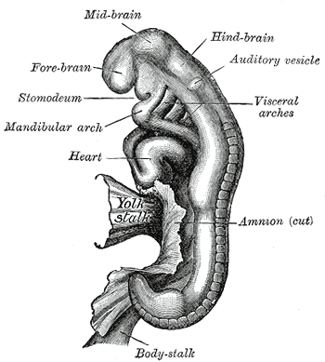
Embryo Example
For example, using Fig. 19.17, P. 665, we can see that if we examine the embryos of fish, reptiles, birds, and mammals, there are stages when the embryos of each of these organisms have a tail and gill pouches. Later these structures are modified for certain uses.
Similarities in the embryos of these organisms points to a common ancestral origin.

Slide 35
Heredity and Molecular Biology
Heredity
When Darwin published his theories concerning evolution, the science of genetics had not yet been established.
Today, we can use the knowledge which we have gained from this field to provide a large amount of evidence to support the theory of evolution.
Molecular Biology
We can also provide evidence for evolution by studying the molecular structures which make up organisms.
Two such molecules are DNA and proteins.
We can determine how closely related two organisms are by comparing their DNA. If two species have similar patterns in their DNA, this similarity indicates that these sequences must have been inherited from a common ancestor.

Slide 36
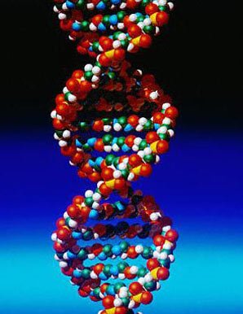
DNA Evidence…
From DNA comparisons, scientists have determined a number of relationships between different organisms.
Examples of organisms which have similar DNA patterns are:
Dogs and bears
Whales and dolphins
cows and deer
Humans and chimpanzees.
The science of molecular biology has shown that all forms of life are related to the earliest organisms to some extent. This has allowed scientists to conclude that all life on Earth probably came from the same ancestor.

Slide 37
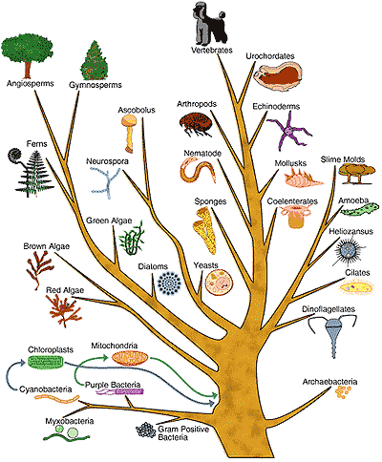
Con’t
Although they may not look similar to each other, organisms will often have similar proteins, such as cytochrome c, which indicates relationships among otherwise dissimilar species.
A diagram called a phylogenetic tree can be used to show what we call a pattern of descent.
Using such a diagram, scientists can determine how certain molecules have changed over time and from this the evolutionary relationships among the organisms in which the changes have occurred.

Slide 38
Defining A Theory
Evolution is considered to be a theory.
The word theory implies that evolution is just a “guess” and not actual fact.
However, the theory of evolution has a large amount of facts or data which can be used to back up what the theory is stating.
Evidence such as homologous structures, DNA sequences, the fossil record, embryology, etc. are all pieces which help to form the puzzle which we call evolution.
As a theory, evolution attempts to explain these facts and tie them together in a comprehensive way. Although there are those who refute the idea of evolution, the evidence for it presents a good scientific argument

