Slide 1
UNIT 2 BIODIVERSITY
Chapter 4
Patterns of Life
Biology 2201

Slide 2
Characteristics of Life
Generally speaking we all know what is living and what is non-living
A butterfly is alive, while a rock is not
A tree is living, while a building is non-living
Rather than defining what “life” is, biologists tend to describe “what makes something living”
What are the characteristics that are shared by all living things?

Slide 3
Thinking Lab
In pairs, examine the pictures on pages 102 – 103. Brainstorm a list of characteristics that enable you to separate living from non-living
Make a list of 6 more living and non-living things (3 of each) and trade with another group to test the reliability of you characteristics
Modify your list as needed

Slide 4
6 Characteristics of Living Things
Organized systems made up of one or more cells
Cells make up tissues, tissues make up organs, organs make up systems. Non-living things do not have this level of complexity
Metabolize matter and energy
Chemical reactions require a source of energy – food

Slide 5
6 Characteristics of Living Things
Interact with their environment and are homeostatic
“stay the same” in an environment even though they are exchanging molecules / water from their surroundings
Grow and Develop
Unicellular living things grow, and divide. Multicellular living things grow, develop through the union of eggs and sperm, followed by cell divisions

Slide 6
6 Characteristics of Living Things
Reproduce themselves
Only living things can make other living things like themselves. Genetic information being passed on to offspring
Adapt to their surroundings
Have physics feature that make them well suited to the environment in which they live – behaviours for obtaining food, waste transport, motility, reproduction and communications

Slide 7
Road to 6 Kingdom Classification
We often tend to organize things based on physical characteristics
Music, clothing, books
The groupings reflect the patterns we see in the world around us
Aristotle first grouped over 1000 organisms into 2 large kingdoms, then subdivided each into smaller groups
1. Kingdom Animalia
Grouped based on movement:
on land
in the air
in water
2. Kingdom Plantae
Grouped based on physical characteristics
Reproductive structures
Types of external tissues

Slide 8
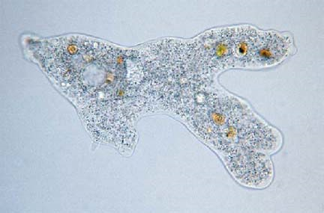
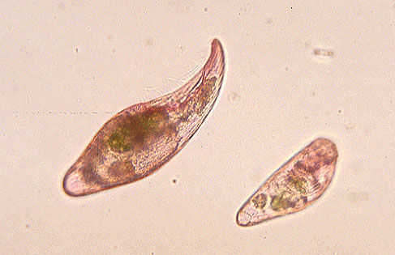
Road to 6 Kingdoms
3. Kingdom Protista
Discovery of micro-organisms forced scientists to reconsider Aristotle’s system of classification
Some organisms move like animals, but photosynthesize like plants

Slide 9
Road to 6 Kingdoms
4. Kingdom Fungi
Were originally included in the plant kingdom
Were placed in their own kingdom because they do not photosynthesize, and absorb nutrients from their environment

Slide 10
Road to 6 Kingdoms
5. Kingdom Bacteria
6. Kingdom Archaea
Entirely made up of prokaryotic cells (lacking a nucleus and membrane-bound organelles)
Obtain energy from a wide range of environments, but thrive between 10 and 40 degrees celcius
Also called: Monera, eubacteria (true bacteria)
Also made up of prokaryotic cells, but with specialized structures allowing them to live in extreme environments
Hot vents, acidic lakes, high pressure, low oxygen, etc.
Also called: archaebacteria

Slide 11
The Three Domains
Each of the kingdoms belongs to one of the three domains
They represent how organisms evolved
See fig. 4.5 pg. 107
Domain Bacteria
Kingdom Bacteria
Earliest living organisms, 1000’s of species exist today
Domain Archaea
Kingdom archaea
Evolved later, through a series of changes in bacteria
Domain Eukarya
Kingdoms protista, plantae, animalia and fungi
Early protists branched away from bacteria, giving rise to all the other kingdoms

Slide 13
Naming and Classifying Organisms
There are well over 2 million different types of organisms known.
Biologists place the organisms into groups based on their characteristics.
By classifying, biologists can organize living things into groups.
Taxonomy
The branch of Biology that deals with the naming and placing of all organisms into groups.
The system of naming we use today was created over 300 years ago by Carolus Linneaus
The Linnean system is very simple to use and became popular as a result

Slide 14
Naming Organisms
Many of the names are based on the Latin or Greek since that is what was used when the naming system was created.
Scientists are required to give new latin scientific names when they discover new species
The names often reflect the characteristics of the organisms, or in some cases honour the discovering scientist

Slide 15
Hierarchy of Groups
Each kingdom is subdivided into smaller and smaller groups called taxa (one taxon)
Kingdoms are the largest taxa, containing 1000’s of species
Species are the smallest taxa, containing only one type of organism
The Taxa
Domain
Kingdom
Phylum (plural – Phyla)
Order
Family
Genus (plura – genera)
Species
Each taxon may have subtaxa

Slide 16
Hierarchical Classification – The Pneumonic
Domain Doctor
Kingdom King
Phylum Phyllip
Order Ordered the
Family Family
Genus Genius to
Species Speak
Each organism is classified based on physical characteristics and DNA relationships
The Species level contains organisms that are similar enough that they can reproduce

Slide 17
Domestic Dog
Kingdom Animalia
Phylum Chordata
Class Mammalia
Order Carnivora
Family Canidae
Genus Canis
Species familaris
Different breeds may exist

Slide 18
Humans
Kingdom Animalia
Phylum Chordata
Class Mammalia
Order Primates
Family Hominidae
Genus Homo
Species Sapien Sapien

Slide 19
Binomial Nomenclature
Binomial = 2 terms
Nomenclature = naming
System of naming species using a two-term name
First term is the genus name
Second term is species name
Rules for naming
The genus name is capitalized
The second name is the species and is entirely lower-case
The name must be either in italics or have each term separately underlined

Slide 20
Binomial Nomenclature Examples
CORRECT WAY
WRONG WAY
Canis familiaris – house dog
OR
Canis lupus – Wolf
Many species may be in the same genus because they are related, in this case dog-like animals
Canis Familiaris
canis lupus
Canis latrans - Coyote
Canis lupus

Slide 21
Common Names
In addition to scientific names organisms may also be given common names.
Common names can cause confusion
Why do you suppose this is?
Example – Pg 112
Shellfish
Starfish
Jellyfish
Crayfish
Catfish
Why are these names misleading?

Slide 22
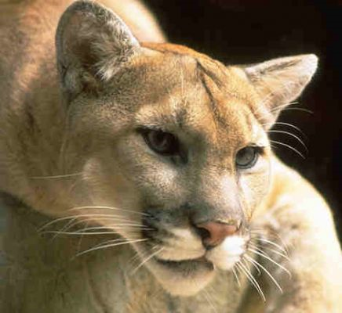
Benefit of Universal Naming
A universal system of naming allows us to avoid the confusion associated with common names, and tells us something about evolutionary relationships.

Slide 23
Dichotomous Keys
A tool used by biologists to identify unknown organisms
Consists of a series of paired comparisons of characteristics used to sort organism into smaller and smaller groups

Slide 24
Today’s Classification Schemes
Taxonomists (scientists who name organisms) use a variety of information to classify or group organisms
The goal of taxonomy is to determine the evolutionary history of organisms
This is done by comparing physical characteristics of modern species with past species
Scientists utilize many techniques to ensure that organisms are classified correctly
Using these techniques many species have been re-classified after being incorrectly so in the past

Slide 25
Evidence: Fossil Record
Using radioactive carbon-14 dating, the age of a fossil can be determined
C-14 decays at a known rate, the amount remaining in a fossil can be used to calculate the age
This evidence shows that major taxa are not as different from each other as they appear
Archaeopteryx shares features with both birds and reptiles. The organism is believed by many to be a modern descendant of birds – That is to say the intermediate between dinosaurs and birds

Slide 26
Evidence: Anatomy
Comparisons are made between the structures of different organisms
Bone structures are similar in many species, even though their sizes and proportions have been modified for different modes of transportation
See Fig. 4.9 – pg 114

Slide 27
Evidence: Biochemical
Many genes are simply instructions for making proteins
By comparing these genes and finding similarities means that different species may be related since they have the same proteins
Many species have been reclassified based on their biochemistry
Guinea pigs
Horseshoe crabs

Slide 28
Evidence: Embryology
Comparisons of early embryological development between different species provides evidence as to how closely related they are
Earnest Haeckel drew embryos of different species for comparison

Slide 29
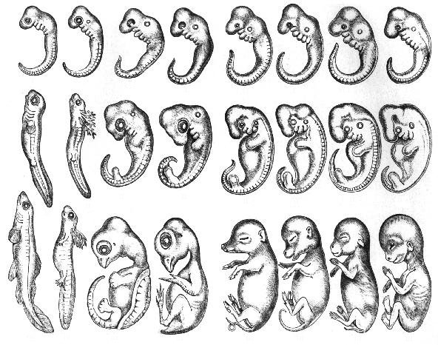
Haekel’s Embryo Drawings

Slide 30
Evidence: DNA / RNA Analysis
Mixing single strands of DNA from two different species to determine percentage of relationship
The greater the bonding between complimentary base pairs, the more closely the two are related
This is done using DNA from the mitochondria because it is passed down from mother to offspring (from the egg)
98% of human – chimp DNA bonds while only 93% of human-macaque monkey DNA bonds To which species are we more closely related?

Slide 31
Phylogeny & Cladistics
Phylogeny – The whole evolutionary history of a species or other taxonomic group. (Figure 4.14 pg. 116).
At the base of the tree is the oldest ancestor
Forks in branches represent divergences of new species
The top of the tree represents the most recent time, so from the base to the top of a branch is a progression through time.
Cladistics – A classification scheme based on phylogeny and the idea that any one group of related organisms was derived from a common ancestor

Slide 32
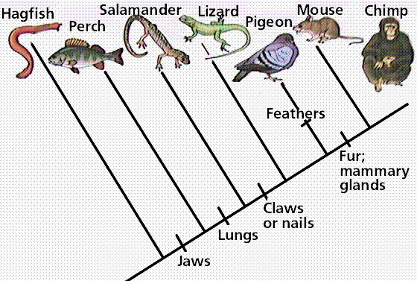
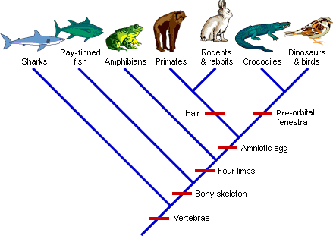
Phylogenetic Trees
Cladogram – A diagram similar to a phylogenetic tree that does not take into account the time of a divergence.

Slide 33
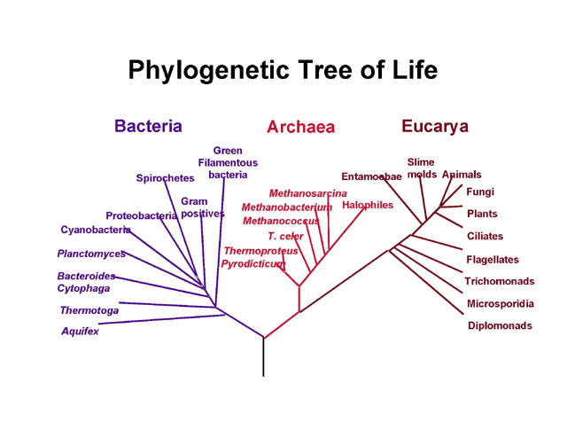
Phylogenetic Tree of Life

Slide 34
Viruses
Non-living particles of DNA/ RNA encased in a protein capsid. The capsid helps to protect the virus from the host cell’s defensive enzymes, and enables the virus to be more host-specific
Capsid

Slide 35
Why Viruses are non-living
No cell structures
No cytoplasm, organelles or cell membranes
No cellular respiration

Slide 36
Lytic Cycle (Viral Replication)
ATTACHMENT – The virus particle must first attach itself to a host cell, generally to a specific receptor site on the cell membrane.
ENTRY – 2 ways this can happen: Injection of the DNA/RNA into the host cell (T4 virus) OR if the virus in an envelop, it will attach to the cell membrane, and the cell will engulf it, forming a vacuole, which it will break out of releasing DNA/RNA
REPLICATION – (lytic cycle – cycle of viral replication) The host cell’s metabolism replicates (copies) the viral DNA/ RNA
ASSEMBLY - New virus particles are assembled inside the host cell
LYSIS AND RELEASE - The host cell breaks (lyses) open releasing the new virus particles

Slide 37
Lytic Cycle Diagram
See page 123, figure 4.21 in textbook

Slide 38
Lysogenic Cycle
Lysogenic cycle – Genetic material from the capsid is released into the host cell. The viral DNA becomes part of the host cell’s chromosome as a provirus. The provirus remains inactive but is replicated with the host cell DNA. The newly replicated viral DNA may then be used in the assembly of new virus particles, continuing on in the lytic cycle.
EXAMPLE: Cold Sores – caused by the herpes simplex virus. The sores appear when the virus is destroying cells, and disappear when the virus is in the provirus stage.
Virus may remain dormant in the provirus phase for years – meaning viral outbreaks may be very rare even though the person carries the virus.

Slide 39
Retroviruses
Retroviruses
Viruses, such as the AIDS, human immunodeficiency virus (HIV)
Are able to transcribe a single strand of RNA into double-stranded DNA using an enzyme called reverse transcriptase
This DNA is incorporated into host genome, and replicated each time the host cell divides
This forms new virus particles, which repeat the process
Process described in Fig. 4.22, page 124
HIV AIDS Virus Particle
http://www.hhmi.org/biointeractive/disease/animations.html

Slide 40
MORE ON VIRUSES
T4 viruses may be used by genetic engineers to copy genes that they are using for their research. (Fig. 4.23, page 125)
DNA/ RNA may be either single stranded or double stranded, and either linear or circular.
70% of all viruses are known to be RNA virus, and since RNA replication frequently involves errors, there is a high rate of mutation in RNA viruses

