Slide 1
Unit 1 Matter & Energy for Life
Chapter 3
Energy For Cells
Biology 2201

Slide 2
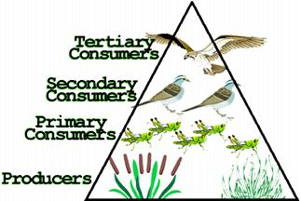
Energy in Cells
Only about 2% of the sun’s energy reaches the earth
Energy is harvested by photosynthesizes
10% of this energy is passed up the food chains from primary consumers up to tertiary consumers.
Some energy is lost as heat during each conversion

Slide 3
Types of Energy
Energy
The capacity to do work
Light, heat, electrical, etc
Potential Energy
Stored energy
Sugar, ATP
Kinetic Energy
Energy of Motion
Chemical Energy
Energy stored in bond in the atoms between molecules
Once bonds are broken the energy is released
Metabolism
Total of all the chemical reactions that take place within a cell
Includes all of the building up and breaking down of substances in a cell
Relies on chemical energy within the cell

Slide 4
Photosynthesis
The process by which an organism captures the energy of the sun to convert CO₂ and water into glucose.
Light energy is converted into chemical energy.
The process looks as follows: Light , chlorophyll
carbon dioxide + water → glucose + oxygen 6CO₂ + 6H₂O → 6C₆H₁₂O₆ + O₂

Slide 5
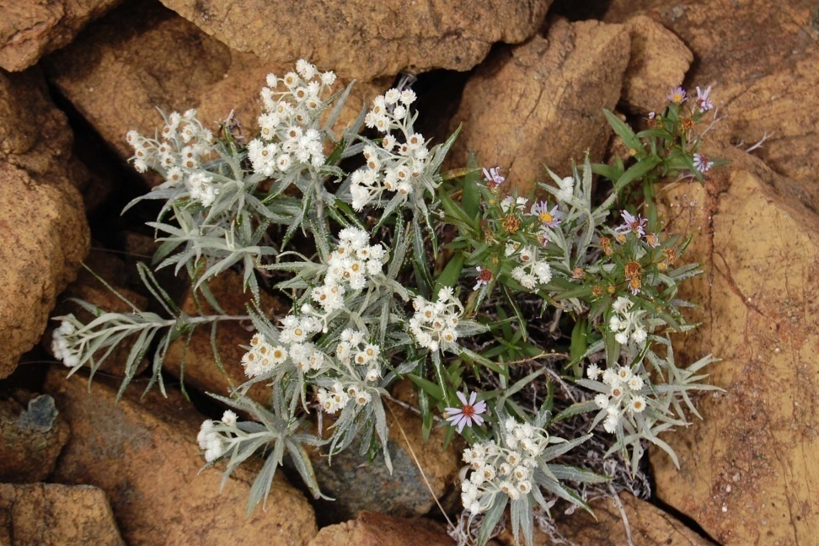
Importance of Photosynthesis
It is the chief source of energy on earth.
It supplies most of the oxygen found in the atmosphere.
It is the first step in food chains.

Slide 6
Who Does It? Who Doesn’t?
Organisms that carry on photosynthesis are called autotrophs or producers. They contain chlorophyll inside cell organelles called chloroplasts.
Organisms that are not able to carry on photosynthesis are called heterotrophs and capture their food. They depend on plants directly or indirectly as their source of food.

Slide 7
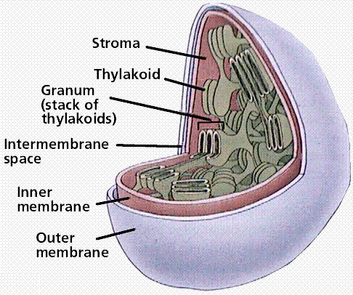
Chloroplast
Energy is put into this system during a ‘Light reaction’ in the Thylakoid.
Sugars are created during a ‘synthesis reaction’ that can take place in the dark. Also called ‘dark reaction’ or ‘Calvin Cycle’

Slide 8
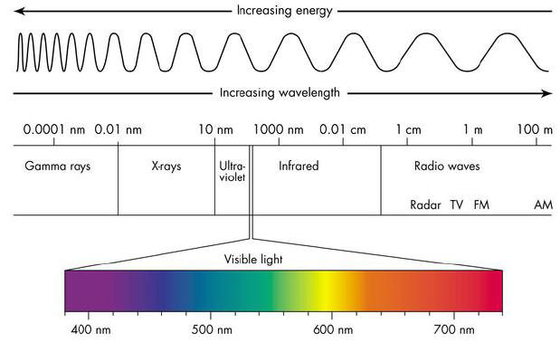
What is Light?
Visible light makes up a very small portion of the range of radiations known as the electromagnetic spectrum.
All light travels as a wave that behaves as a particle
Composed of small packets of energy called photons

Slide 9
Photosynthetic Pigments
In order to capture sunlight, plants require special pigments.
A pigment is any substance that can absorb light.
Several types of pigments are necessary to trap the full light spectrum.
These pigments consist of
red, orange, yellow, green, blue, and violet

Slide 10
Pigments - Chlorophyll
Most important pigment
Present in the largest numbers compared to other pigments
Capture red and blue light while reflecting green
Green in color
There are two types
Chlorophyll A
This is the primary photosynthesis pigment. It directly converts light energy to chemical energy.
Chlorophyll B
Absorbs light energy and transfers it to chlorophyll A.

Slide 11
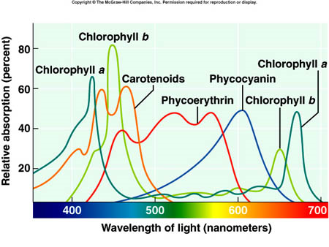
Carotene & Xanthophylls
Carotenes
Orange in colour
Xanthophylls
Yellow in colour
Both absorb light in the regions of the colour spectrum no covered by chlorophyll

Slide 12
Light Reaction vs. Dark Reaction
Light Reaction
Dark Reaction
Requires light and takes place on the thylakoid membrane of the chloroplast.
Chlorophyll captures the sun’s energy and uses it to produce oxygen and high energy compounds which are used in the dark reaction.
Does not require light, but does depend upon the high energy chemical products made in the light reaction.
This reaction occurs in the stroma.
The reaction produces glucose and is often called carbon fixation

Slide 13
Rate of Photosynthesis – 4 Factors
Light Intensity
The greater the amount of light, the more photosynthesis occurs
Temperature
below 0ºC and above 35ºC there is little photosynthesis
Water
when in short supply, photosynthesis slows down
Minerals
When in short supply, photosynthesis slows down

Slide 14
Cellular Respiration
This is the process of releasing energy, within a cell, through a complex series of chemical reactions.
It occurs at the mitochondria, and consists of the step-by-step breakdown of a nutrient, most commonly glucose, in order to release energy.
This energy is then stored in the cell in the form of ATP.
C₆H₁₂O₆ + 6O₂ → 6CO₂ + 6H₂O + ATP glucose + oxygen →carbon dioxide + water + ATP

Slide 15
Importance of ATP formation
The energy stored in glucose is not readily available to all cell parts, whereas ATP is.
Releases energy in the cell with greater control than if the energy came directly from glucose.
The ATP acts as the intermediary between energy-releasing (exergonic) and energy-requiring (endergonic) reactions in the cell

Slide 16
What is ATP?
Adenosine Triphosphate
A high-energy compound found within cells
Composed of a molecule of adenosine and three molecules of phosphate. The phosphates are held to the adenosine by high energy bonds
The bonds break, releasing energy along with ADP (adenosine diphosphate) and a phosphate

Slide 17
ATP –ADP Cycle
breakdown of glucose (energy in)
+ P
ADP
ATP
- P
cellular activity (energy out)

Slide 18
Aerobic vs. Anaerobic Respiration
Aerobic Respiration
Anaerobic Respiration
Glucose is completely oxidized into CO₂ and H₂O in the presence of O₂ to release energy.
It is the most common form of glucose breakdown, and allows for the maximum amount of energy to be released from the glucose
Ongoing in all cells most of the time to produce energy
Glucose is broken down in the absence of oxygen to release energy.
It creates little energy for the cell. It occurs in smaller organisms and in larger organisms when oxygen is not present.
Location
It occurs in the cytoplasm of plant and animal cells.
Muscles get sore during exercise because of the lactic acid build-up in the tissues resulting from A.R

Slide 19
Two Aerobic Respiration
Alcohol Fermentation:
C₆H₁₂O₆ (glucose)
2 C₂H₅OH (ethyl alcohol)
+
2 CO₂ (carbon dioxide)
Lactic Acid Fermentation:
C₆H₁₂O₆ (glucose)
2 C₃H₆O₃ (lactic acid)

Slide 20
The Carbon Cycle
Respiration and photosynthesis are dependant upon each other
Two halves of the carbon cycle
Photosynthesis produces the raw materials for respiration, and respiration produces the raw materials for photosynthesis

Slide 21
The Carbon Cycle
CO₂ in the atmosphere
Photosynthesis - carbon is stored in the biomass
volcanic eruption
CO₂ dissolved in water
combustion
Glucose
Aerobic respiration
Ocean sediment
Decomposition
Weathering
Conversion to fossil fuels
Fossil fuels

Slide 22
How Do we Affect the Carbon Cycle?
Agriculture
Clear-cutting
Mining
Burning fossil fuels
See page 88 in textbook
Each of these has an overwhelming effect o the levels of carbon available for cycling
All of which add carbon to the atmosphere, affecting levels stored in biotic sources (plants / animals)

Slide 23
Chapter 3 Review and Test
Chapter Review Assignment Hand-out Questions Due: __________________________
Test Date: __________________________

